Slide 1

Next Gen Geotechnical Engineering
Multi-channel Analysis of Surface Waves
(MASW)
Presented by
Suitable for All Ages
Version 6.0 20240131

Slide 2
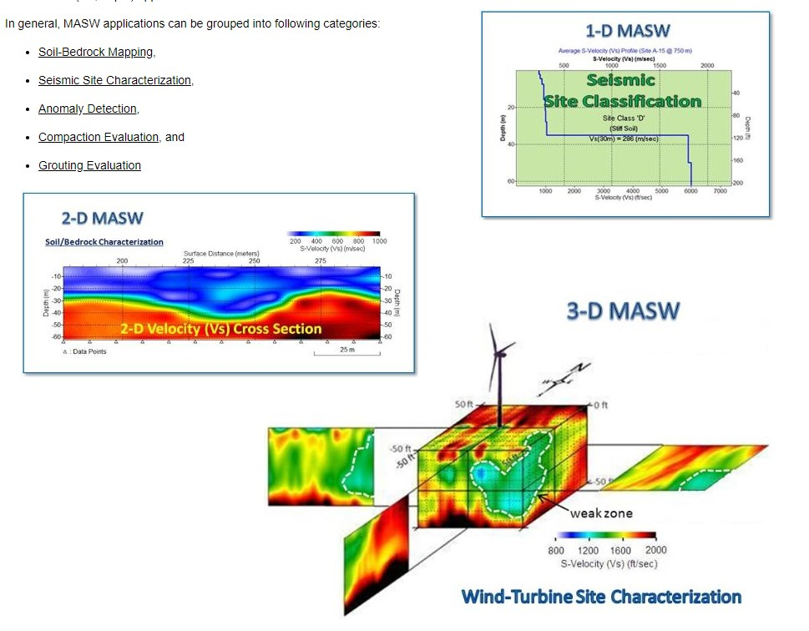
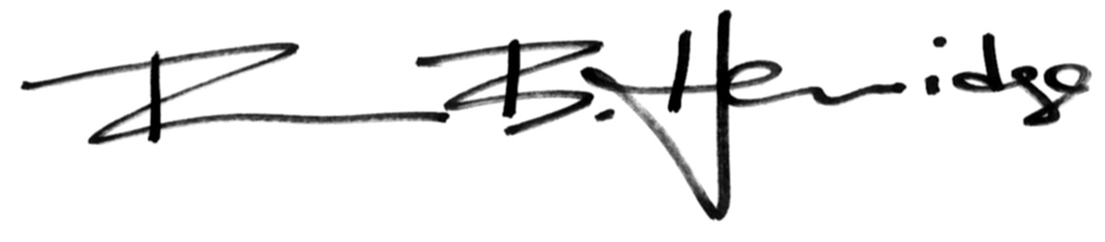
Multichannel Analysis of Surface Waves (MASW)
MASW has forever changed Geotechnical engineering the way CAT-Scan changed medicine. It is simply the most important development in the history of the Geotech science
Brian B. Herridge
PARK Seismic LLC

Slide 3

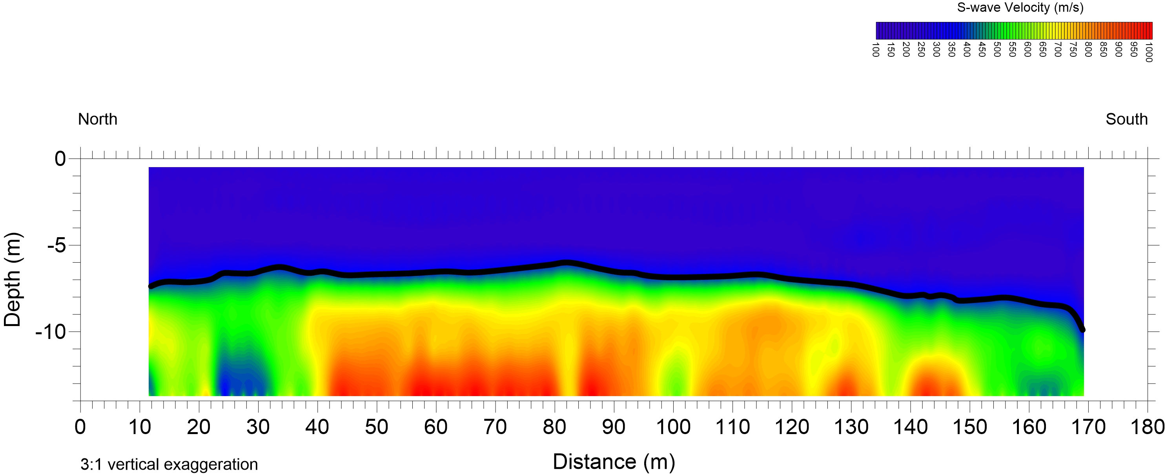
All Terrain Capable Subsurface Strength Profiling
Overview
PROBLEM statement
Technical discussion
Application examples
Depth to Bedrock Cross Section

Slide 4
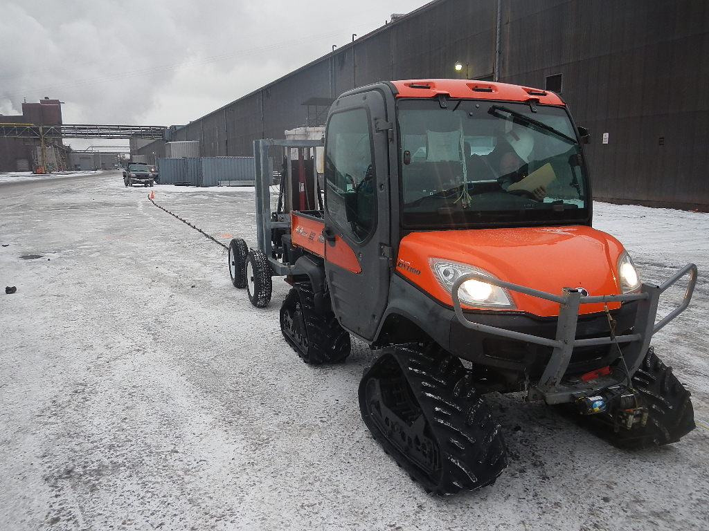
The Problem
What technology
can reliably image from 0 to 100 ft?

Slide 5
Technical discussion

Slide 6
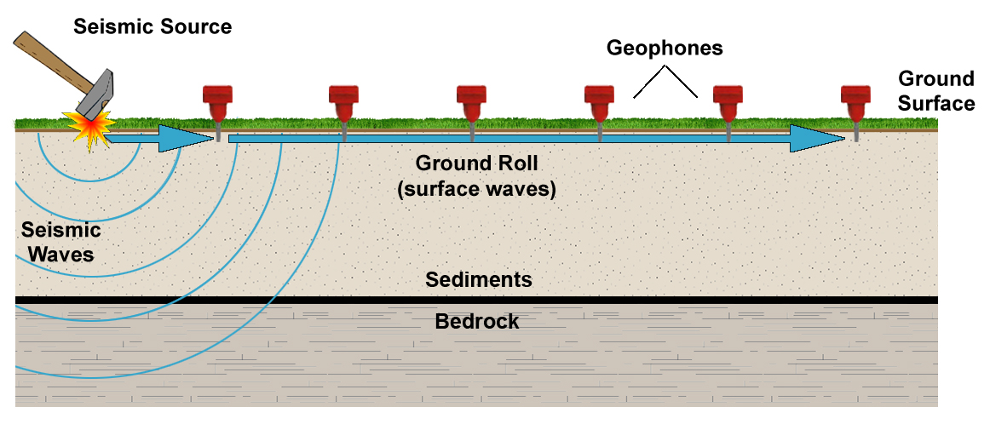
What is Masw?
Definition: MASW surveying is a non-intrusive imaging technique that is performed on the ground surface. MASW is a seismic method that generates two-dimensional cross sections of shear wave velocity versus depth by analyzing surface waves on multi-channel seismic records.
Shear-Wave (S-wave) Velocity related directly to Material Shear Strength

Slide 7
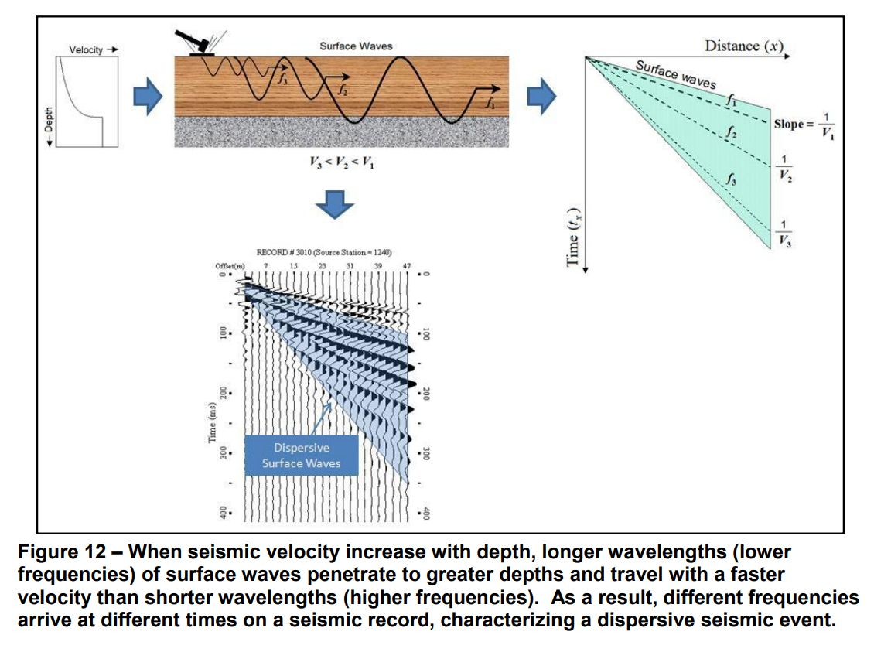
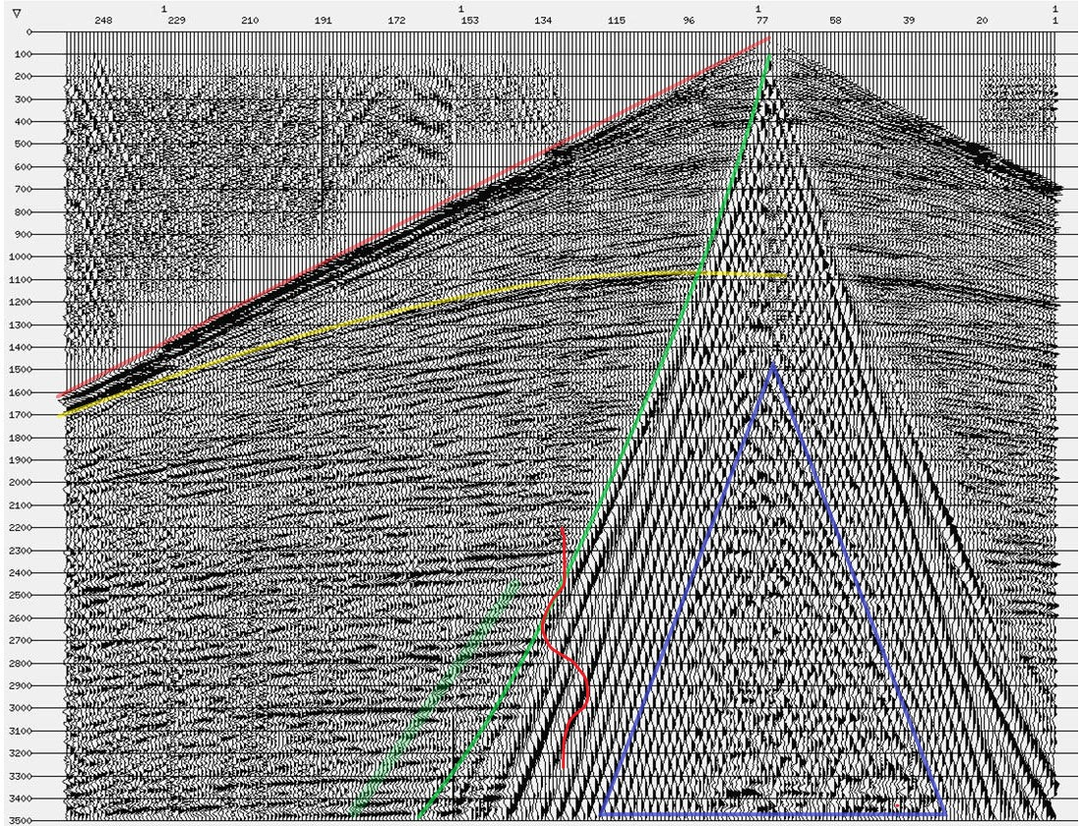
how does it work?
HOW DOES IT WORK
The objective of MASW shooting is to generate the necessary spectrum of surface waves then measure the speed of each of those useful frequencies.
This a robust process because surface waves are generally very large amplitude events compared to others.
Unlike refraction Analysis The frequencies are distilled and clocked not using a single sample but all of the samples in a record.
The seismic record to the right is 240 channels using a dynamite shot for the source at station 77.
The red wavelet drawn on the record is 2 Hz - The lower end of useful signal using MASW. A low frequency Source {not a sledge Hammer} is required to generate frequencies as low as 2 Hz.
MASW PROCESS
Surface Waves

Slide 8
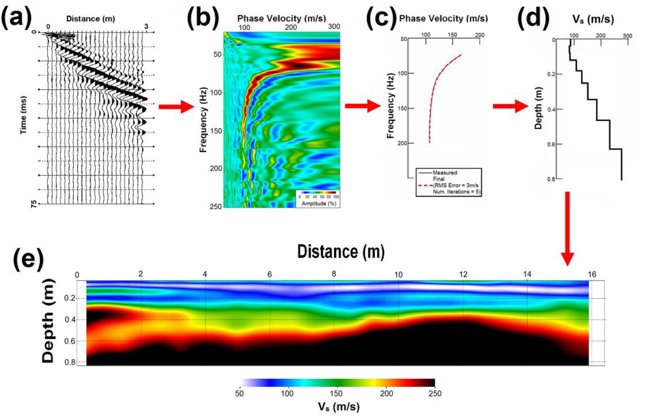
What is the Process?
STEPS
(A) Collect a seismic record
(B) Surface wave “spectra” are calculated
(C) Dispersion curve (velocity vs frequency) of the data record is interpreted
(D) Inversion analysis produces a 1D velocity vs depth model
(E) 1D models from multiple records taken in a line are combined & interpolated to generate a 2D cross section
Image from Donohue, Forristal, & Donohue (2013)

Slide 9
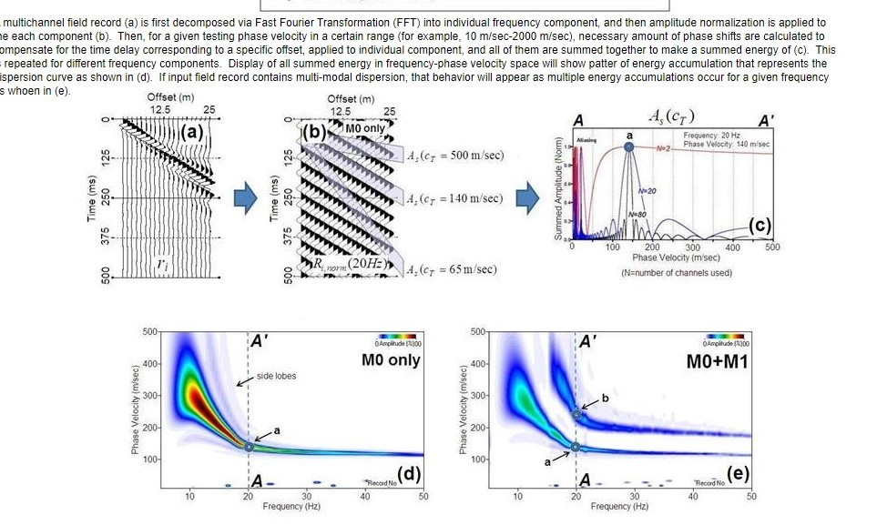
“Slant Stack” – The Heart of the technique
STEPS
(A) Collect a seismic record
(B) Surface wave “spectra” are calculated
(C) Dispersion curve (velocity vs frequency) of the data record is interpreted
(D) Inversion analysis produces a 1D velocity vs depth model
(E) All 1D models from multiple records are combined & interpolated to generate a 2D cross section
Image from Donohue, Forristal, & Donohue (2013)

Slide 10
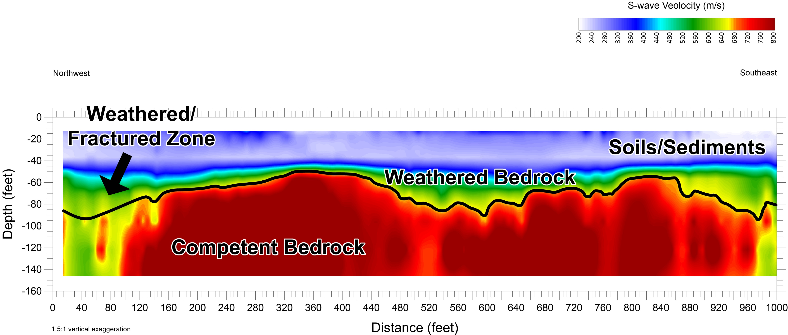
Typical 2D “Strength” PROFILE - Cross section MASW results
S-Wave velocities are different for various subsurface layers. In general, bedrock produces much faster velocities than unconsolidated sediments. The depth to the faster layers varies across the site. The velocity that a certain frequency travels at is a function of the depth to various layers. By measuring the speed of each frequency across the site a layer model can be created mimicking the geology and detailing the structure and shear strength distribution across the site.
Depth to Bedrock Profile

Slide 11
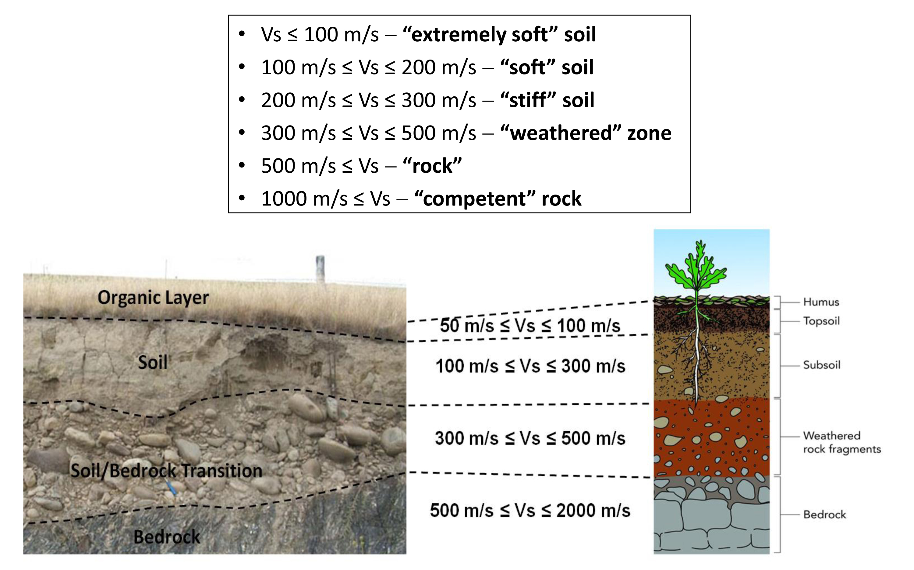
Shear wave velocity to geology correlation
Image provided by Park Seismic, LLC

Slide 12
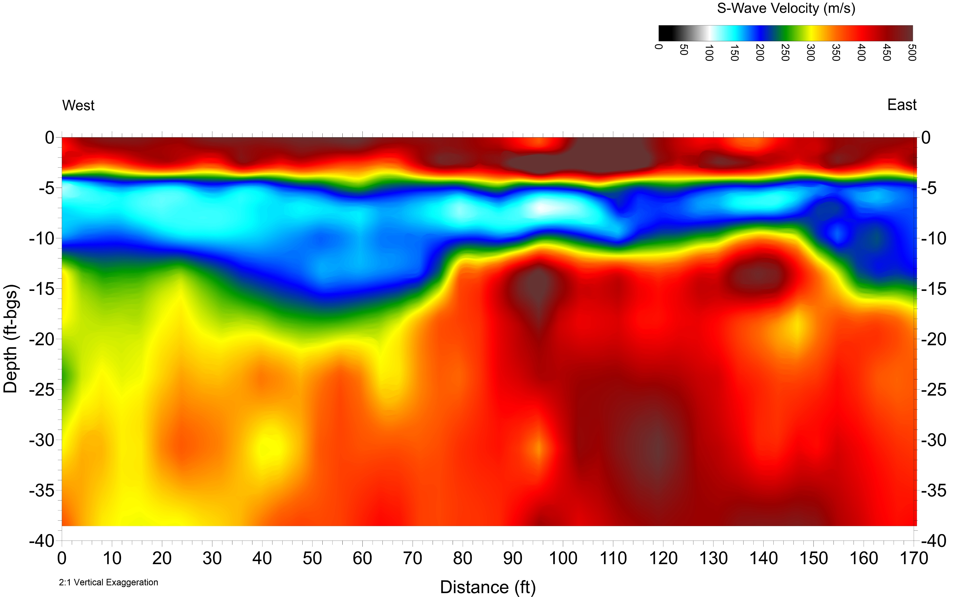
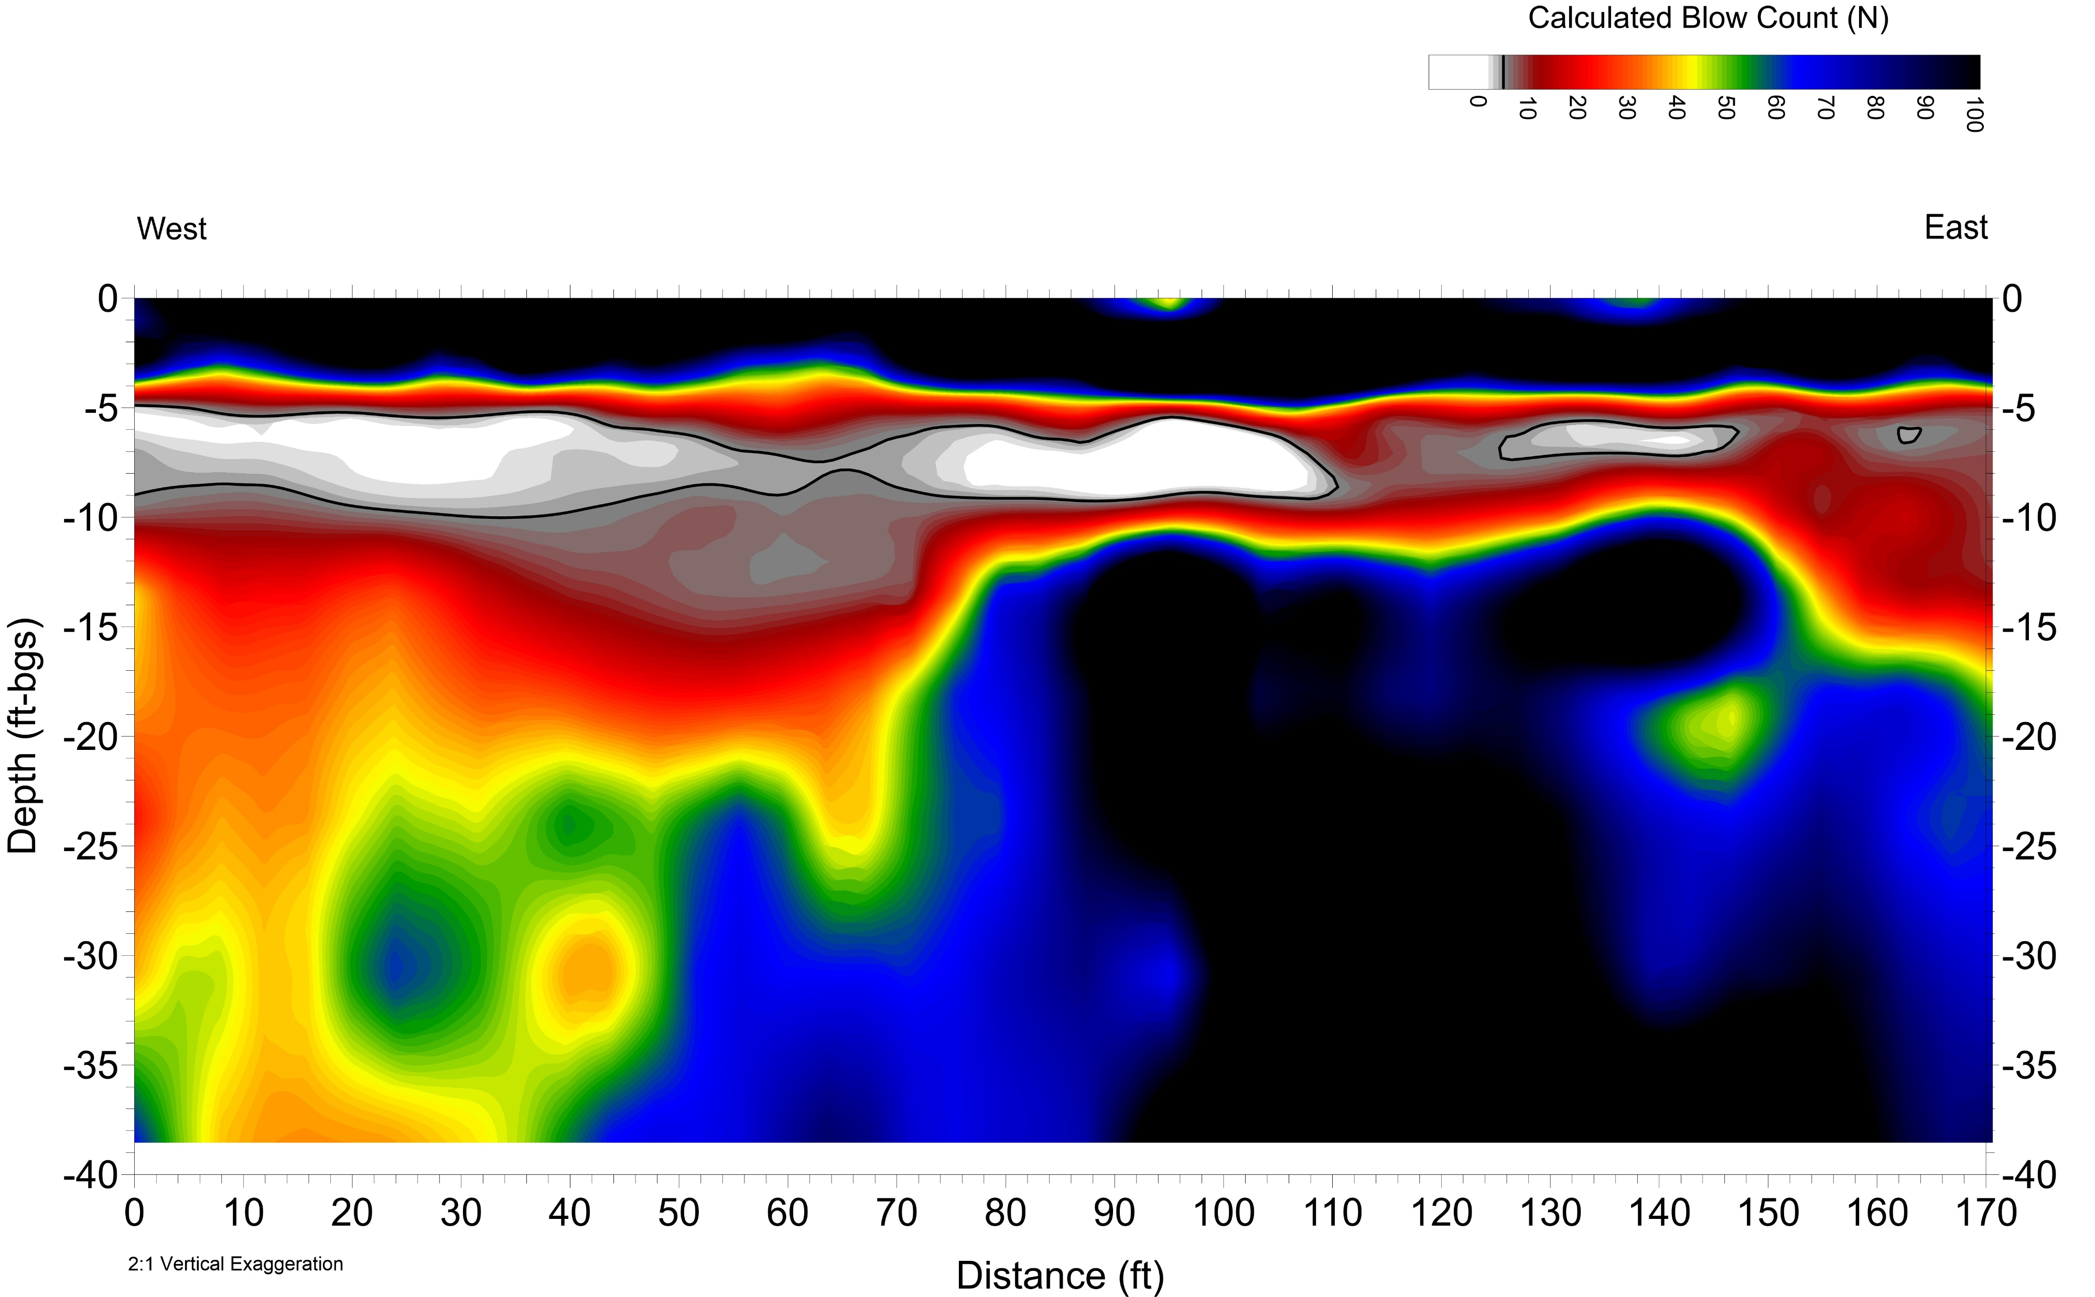
Shear wave velocity Converted to Standard Penetration N “140 Pound Hammer Drive w/ Split Spoon - blows per foot”
Research by Imai, et al. [1975] provided a formula to convert MASW S-wave velocities (“Stiffness”) to N-Values (“Blow Counts”), which is equivalent to a Standard Penetration Test (SPT) familiar to Geotechnical Engineers
Shear-Wave Velocity Cross Section (Stiffness)
Calculated SPT Cross Section (N-Value – Blow Count)
N=1
N=1

Slide 13
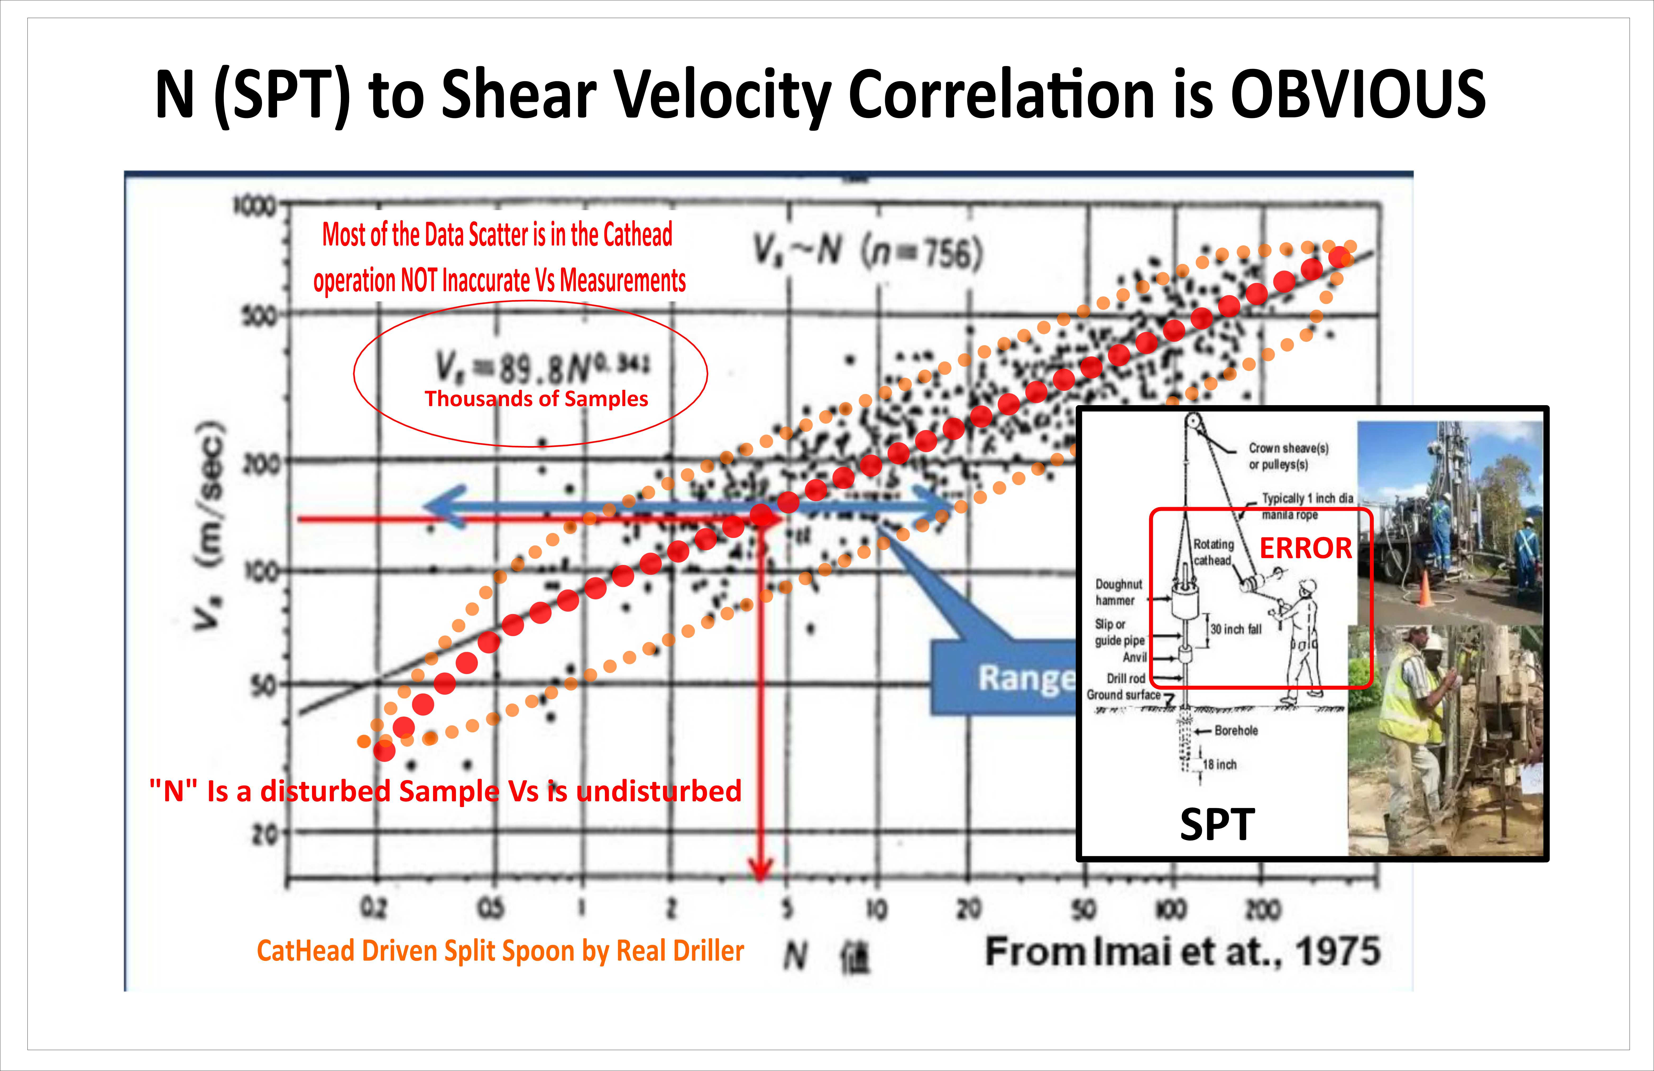

Slide 14
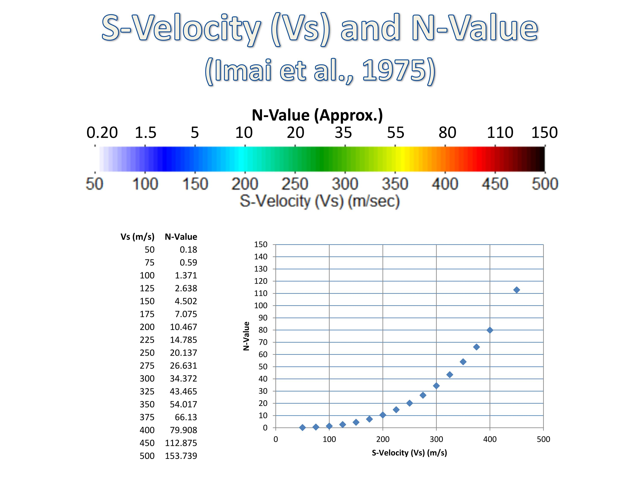
Converting Shear wave velocity to Std Penetration (n)
PARK Seismic LLC
Based on research from thousands of bore holes logging shear wave velocity and Blows per Foot (N) of a standard 140 lb hammer ASTM hammer
Imai & Yoshimura, “The Relation of Mechanical Properties of Soils to P- and S-wave Velocities for Soil Ground in Japan”, Oyo Corporation (Sept 1975)

Slide 15
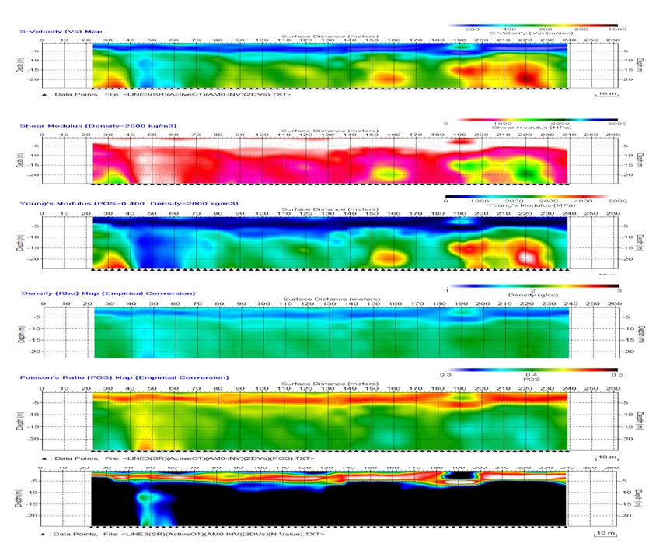
Convert Shear wave velocity to other useful Properties
Present Defendable Lower Cost Designs Using Real Non-Disturbed Material Strengths
Shear Wave Velocity
Shear Modulus
Young’s Modulus
Density
Poisson’s Ratio
SPT “N” Value
PARK Seismic LLC

Slide 16
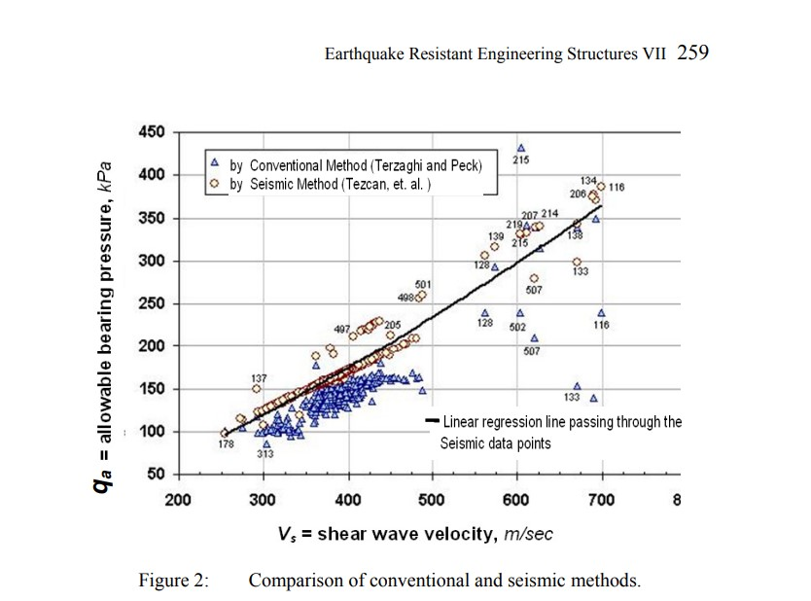
Convert Shear wave velocity to Bearing Capacity
Present Defendable Lower Cost Designs Using Real Non-Disturbed Material Strengths
PARK Seimic LLC

Slide 17
MASW application Areas
DISCIPLINES | AREAS OF APPLICATION
Geotechnical Engineering Structural Engineering Environmental Engineering Mining Engineering Transportation – Roads, RR & Highways Energy Sector (Fossil Fuels, Wind, Solar) Real Estate Development Pre Purchase Agreement - Site Screening Utility Design (sewer to fiber) - Lay Out Pipelines, buried Power Lines, Fiber Lines Structure Forensics Industrial Process Testing and Remediation | Depth to Bedrock - Rippability Sediment thickness Soil classification Fractured zone mapping Karst detection (void Detection) Buried stream channel location Environmental Site Assessments Flow pathway location Foundation studies – Structural Review Soil Improvement/ Grouting Borehole Siting Utility corridor Exploration (sewer coarse def) Required Noninvasive examination

Slide 18
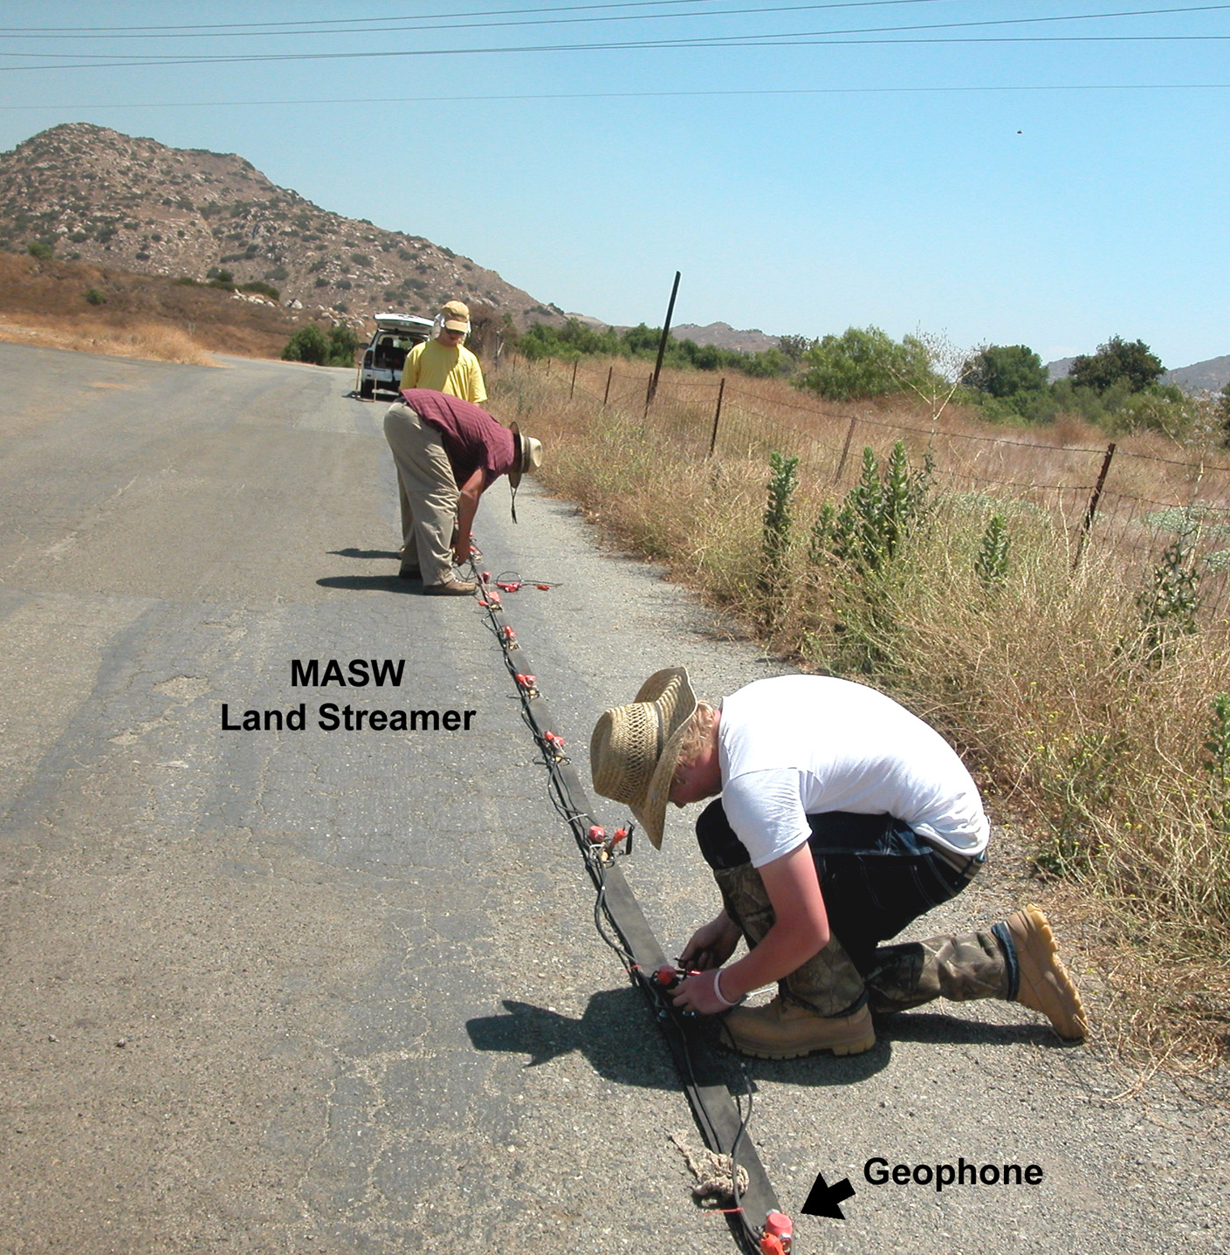
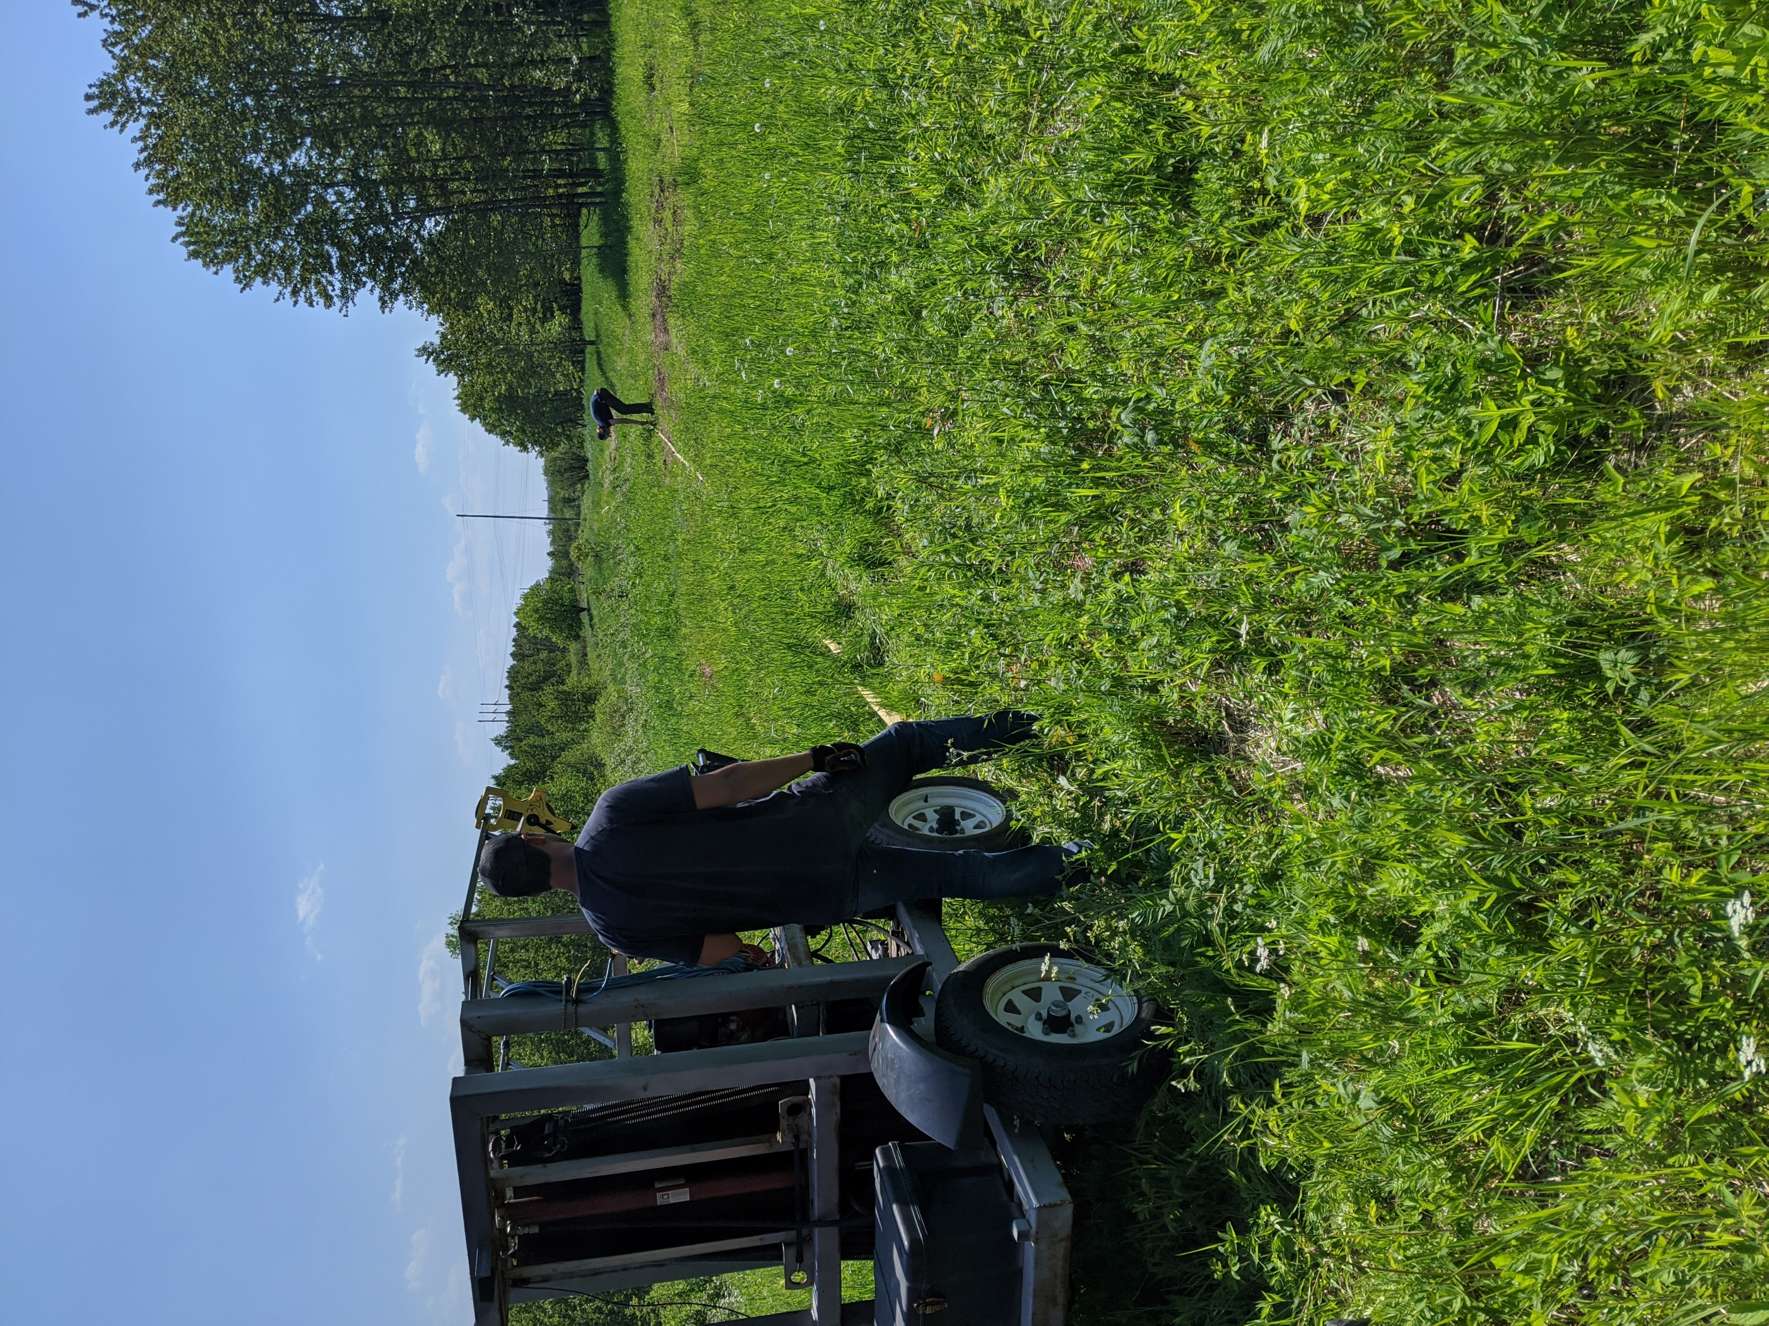
MASW Survey equipment
EQUIPMENT | FUNCTION
Seismograph | Digitally records the MASW data
Seismic Source | Generates the seismic surface waves
Land Streamer | Geophone sensor array that detects the generated surface waves
Tow Vehicle | 4x4 truck or UTV that pulls the seismic source & the land streamer
GPS | Provides survey positioning for MASW data processing & elevation control
Auto-Hammer Seismic Source

Slide 19
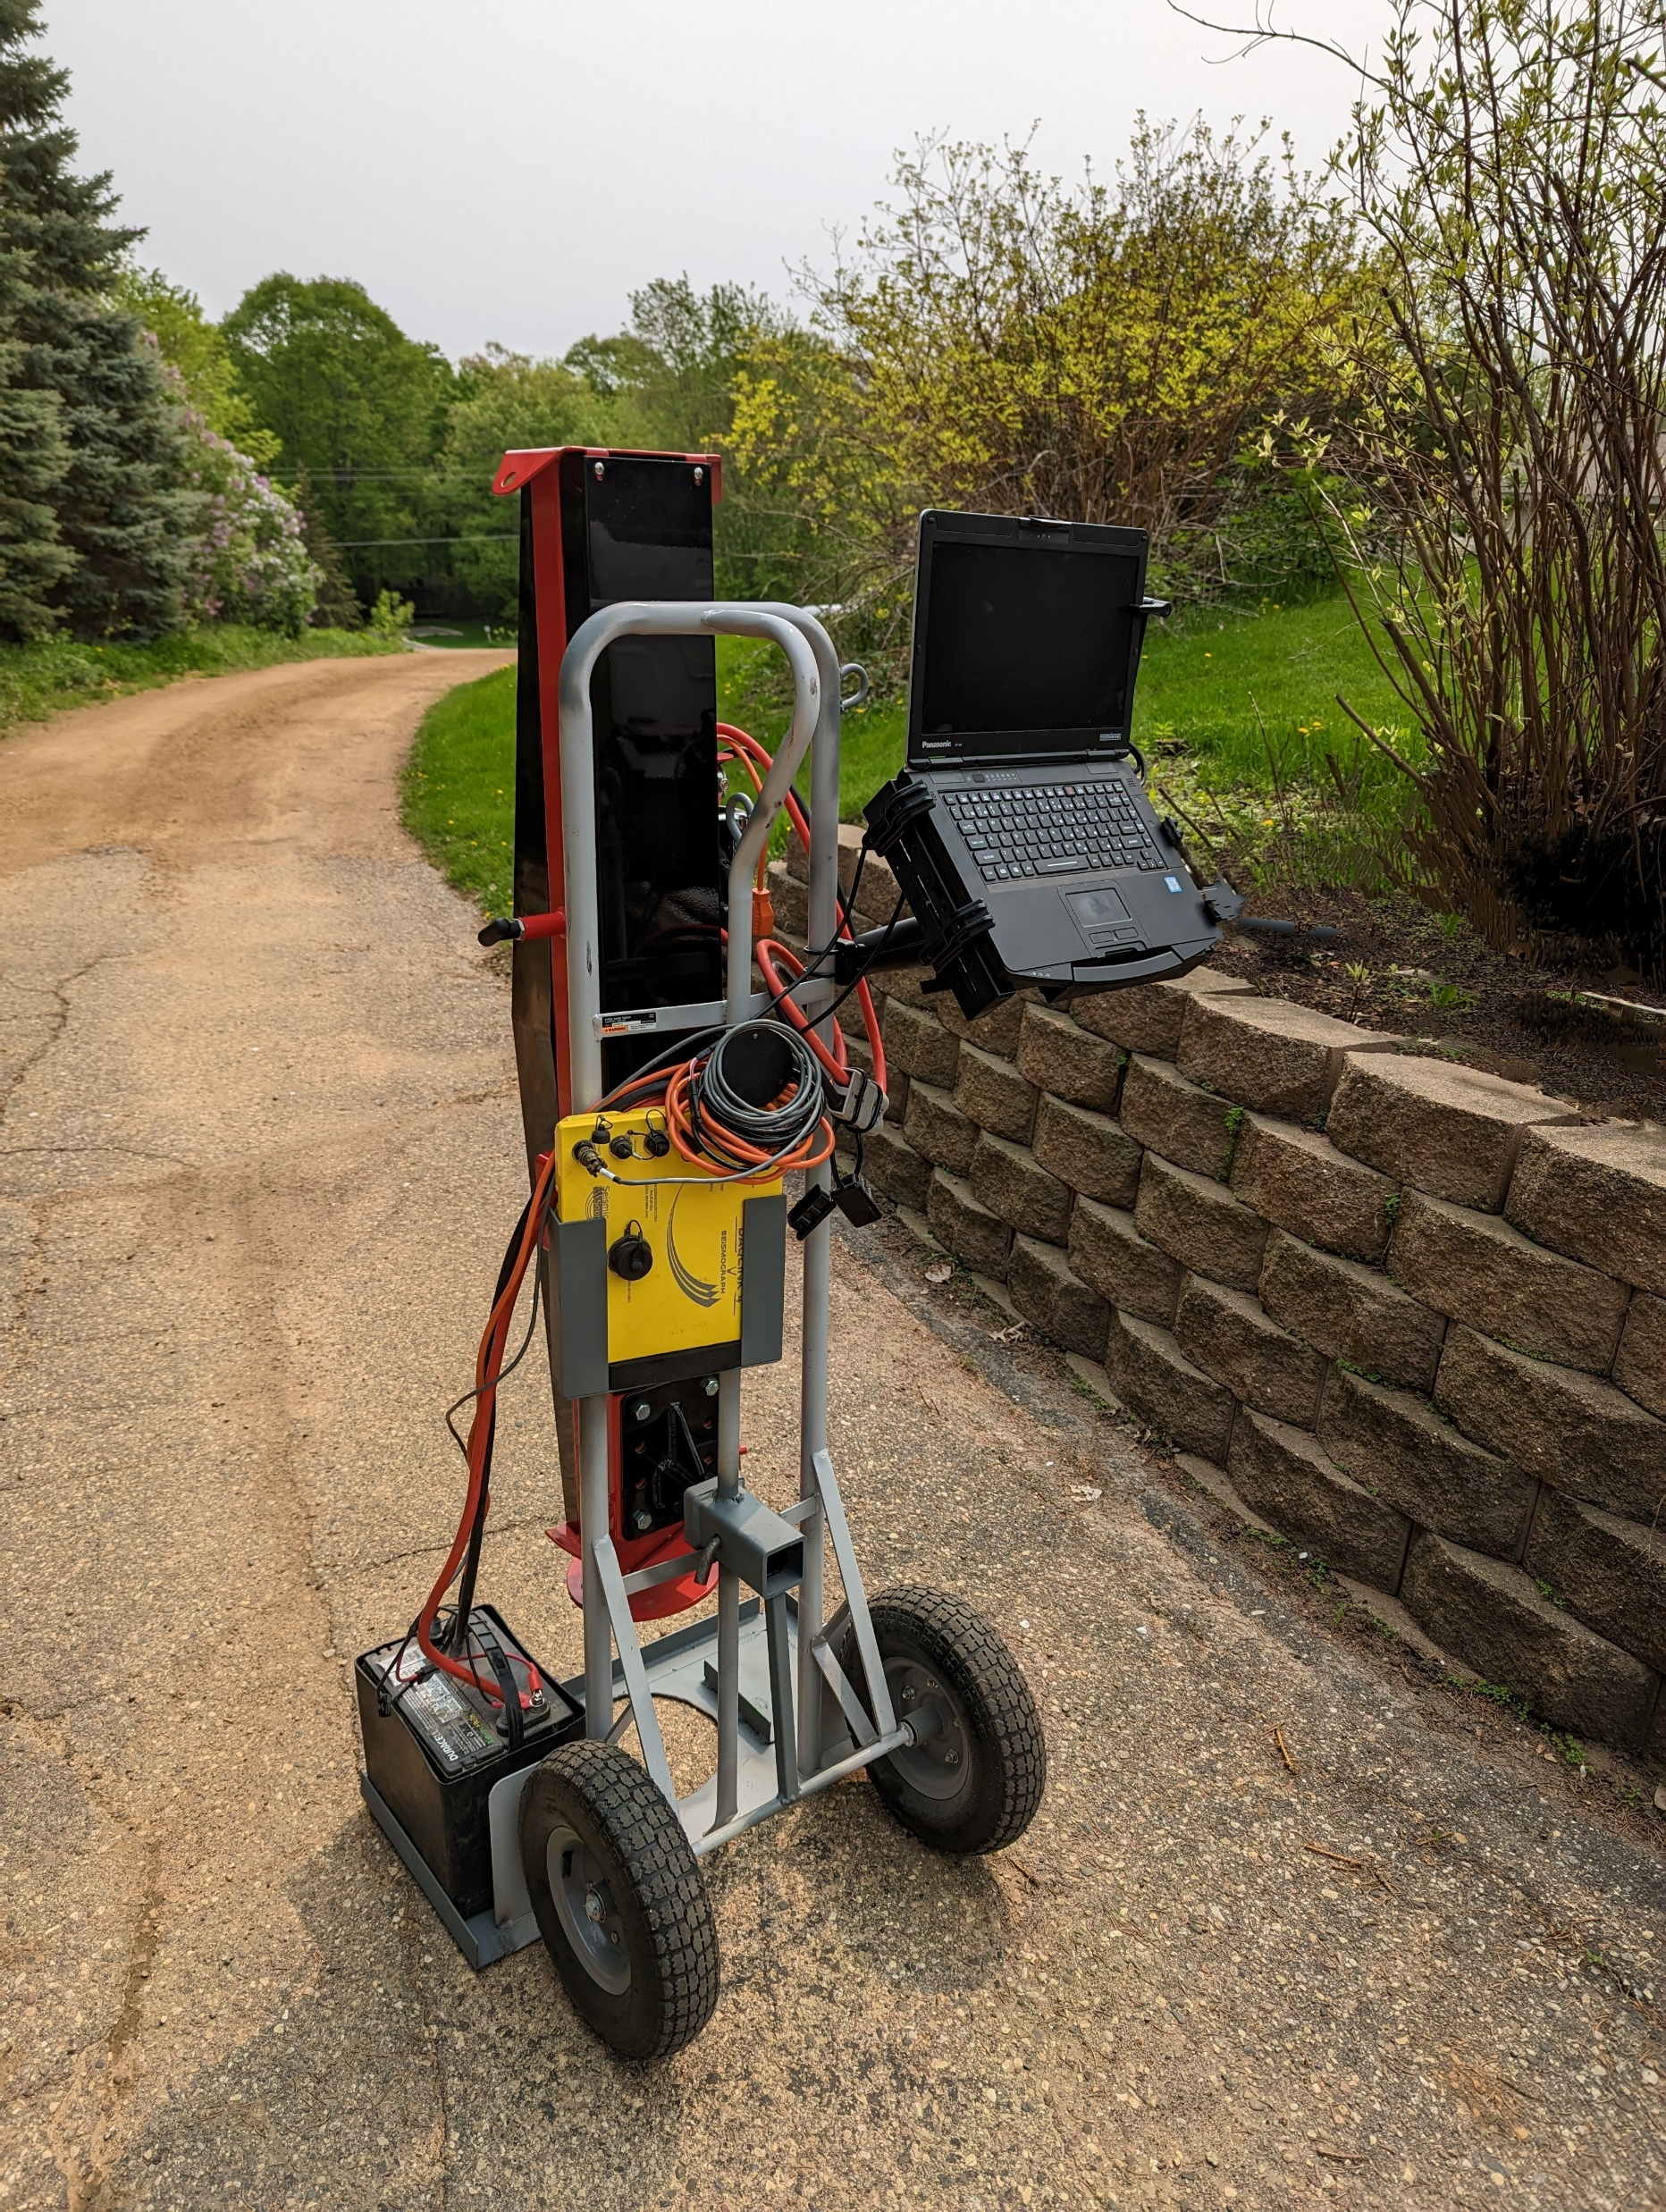
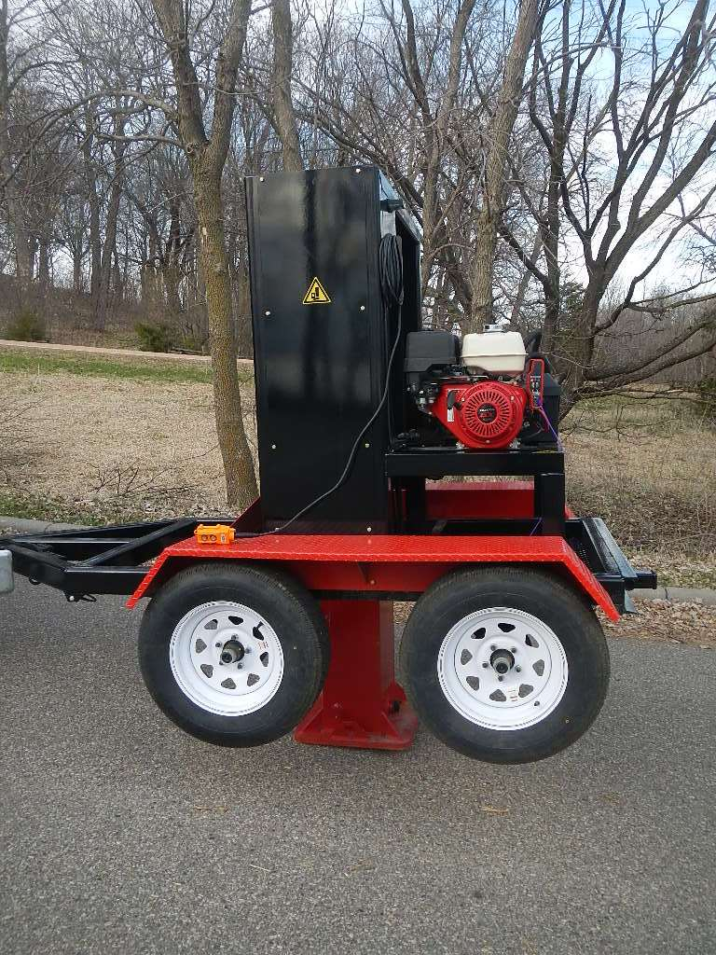
Seismic sources Used FOR Active MASW SURVEYING
Consistent FREQUENCY and AMPLITUDE of surface waves generated by the Seismic Source is critical to the quality of the MASW data. It is usually difficult to control NOISE so we need to control SIGNAL to overcome site noise. In general, large automatic impact sources produce the best results.
Sledge Hammers are not the recommended MASW source contrary to some publications and popular belief. They are the LOW COST source. It is almost always better to have a consistent auto stacking source. When you need 8 or 16 pops per station, sledge hammers and modern humans do not mix.
SOURCE | SURVEY DESCRIPTION
4-lb Hand Maul | Ultra-Shallow depth (1-10 ft)
16-lb Sledgehammer | Shallow depth (1-20 ft)
50-lb Auto-Hammer | Medium depth (5-50 ft)
750-lb Auto-Hammer | Large depth (10-200 ft)
BB50 Auto-Hammer
BB750 Auto-Hammer

Slide 20
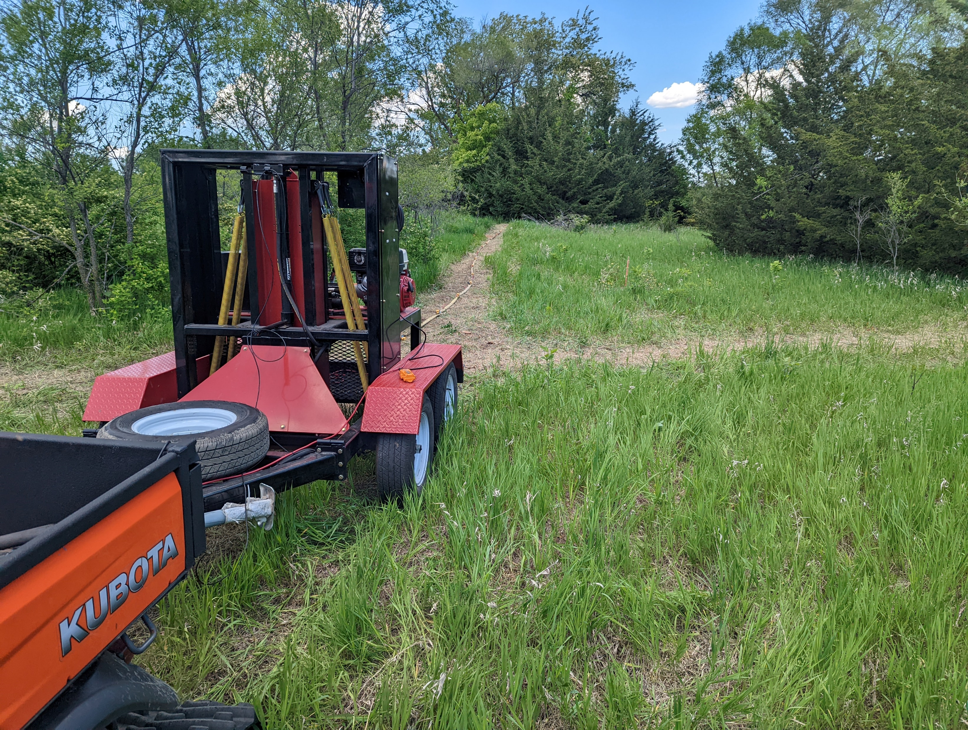
Big Bang 750
>For Best Results require a Large Active Source
>Large Active Sources facilitate 1 Pop/station
>Large Active Sources 0ut Perform Sledge Hammers
>Stack Multiple Impacts where Necessary
>Try Not to use a Hammer Plate

Slide 21
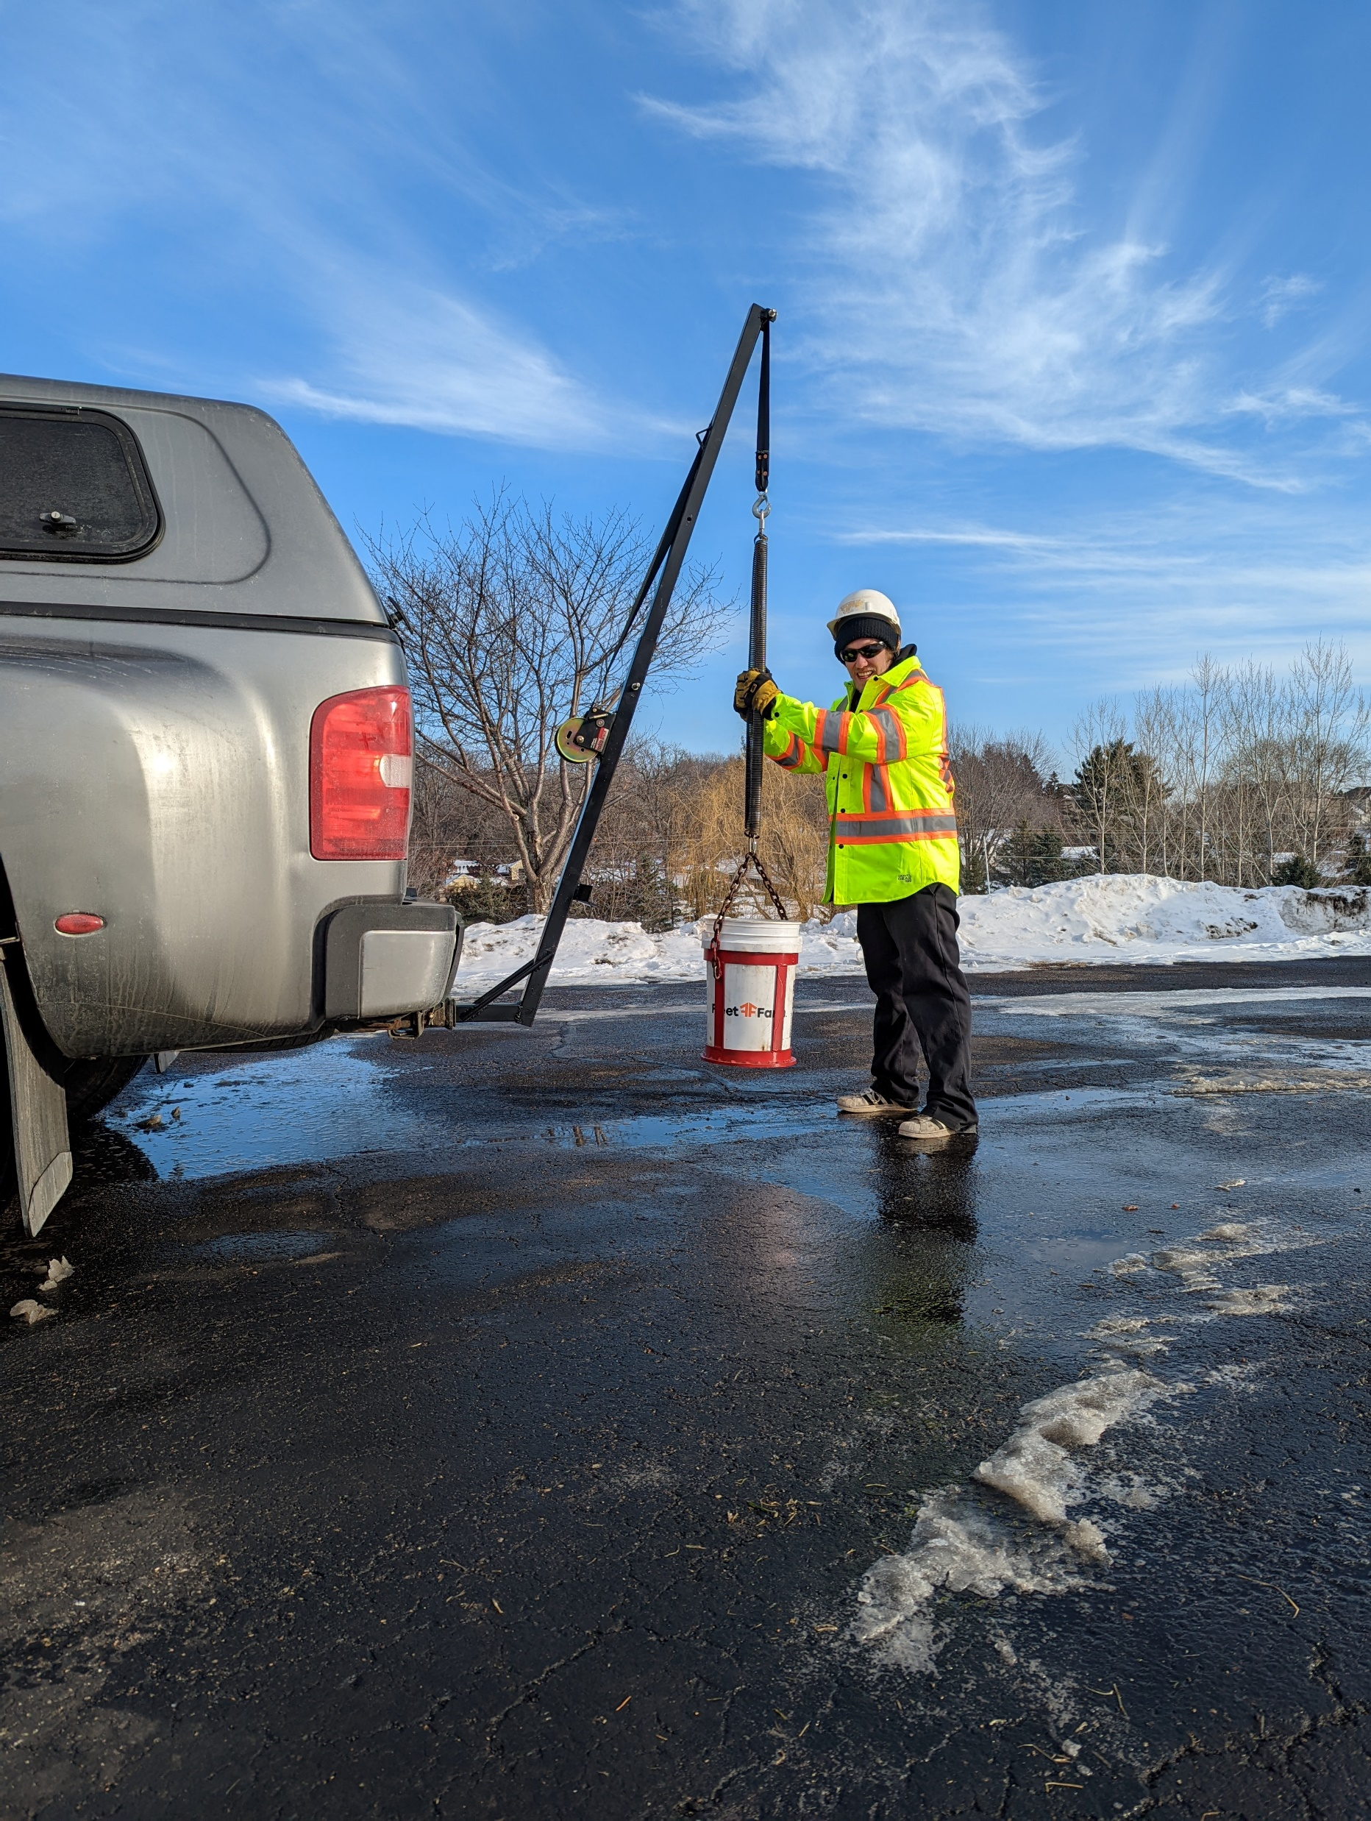
A Better Low Cost
One Hz Seismic Source
Garage door springs
60 lbs Impact
3Dgeophysics ONE Hz
Low Cost MASW Source
Sledge Hammer Seismic Source

Slide 22
Application examples

Slide 23
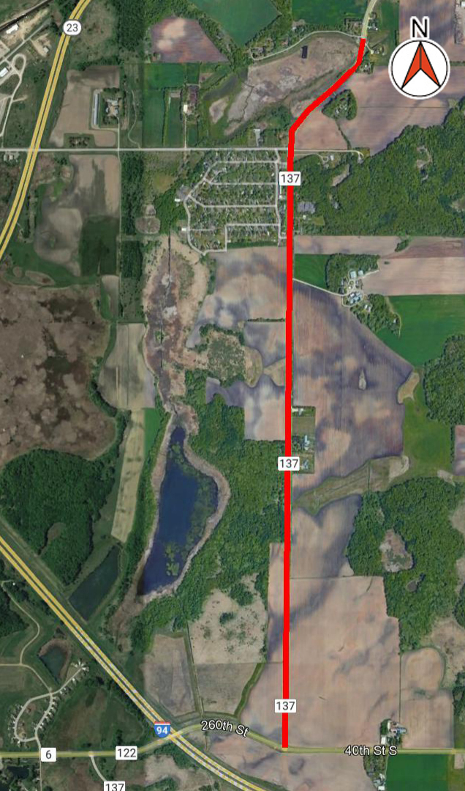
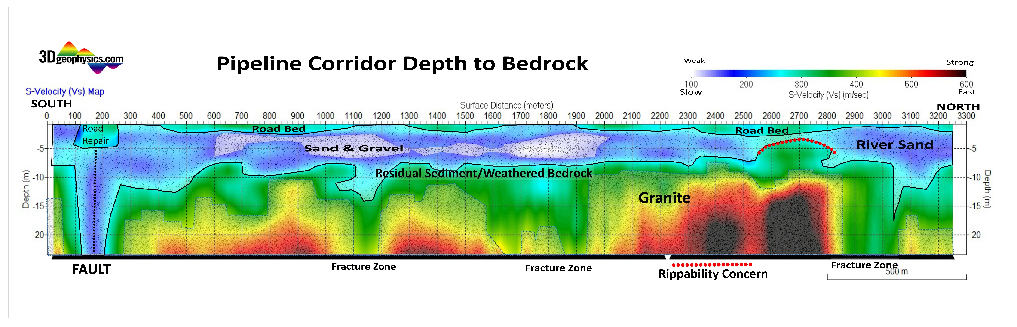
Pipeline CORRIDOR - bedRock Rippability Study
Proposed municipal utility corridor for new residential development in Central, MN (red line on map). MASW surveying was conducted along the 10,585 ft (3226 m) corridor to define the weathered bedrock surface in a way drilling alone could not.
Undulating near surface Granite bedrock was expected to be encountered between 0 – 40 ft; removal of near-surface bedrock often requires BLASTING that greatly increase construction costs.
The City used the data to provide contractors detailed subsurface information in the pre-bidding process. In the end only about 100 meters of 3300 meters (3%) required special excavation but pre BID knowledge of the bedrock elevation high saved millions by avoiding cost overruns during construction. The reader take notice the one remnant granite knob sits atop the largest, least weathered, bedrock high along the line.

Slide 24
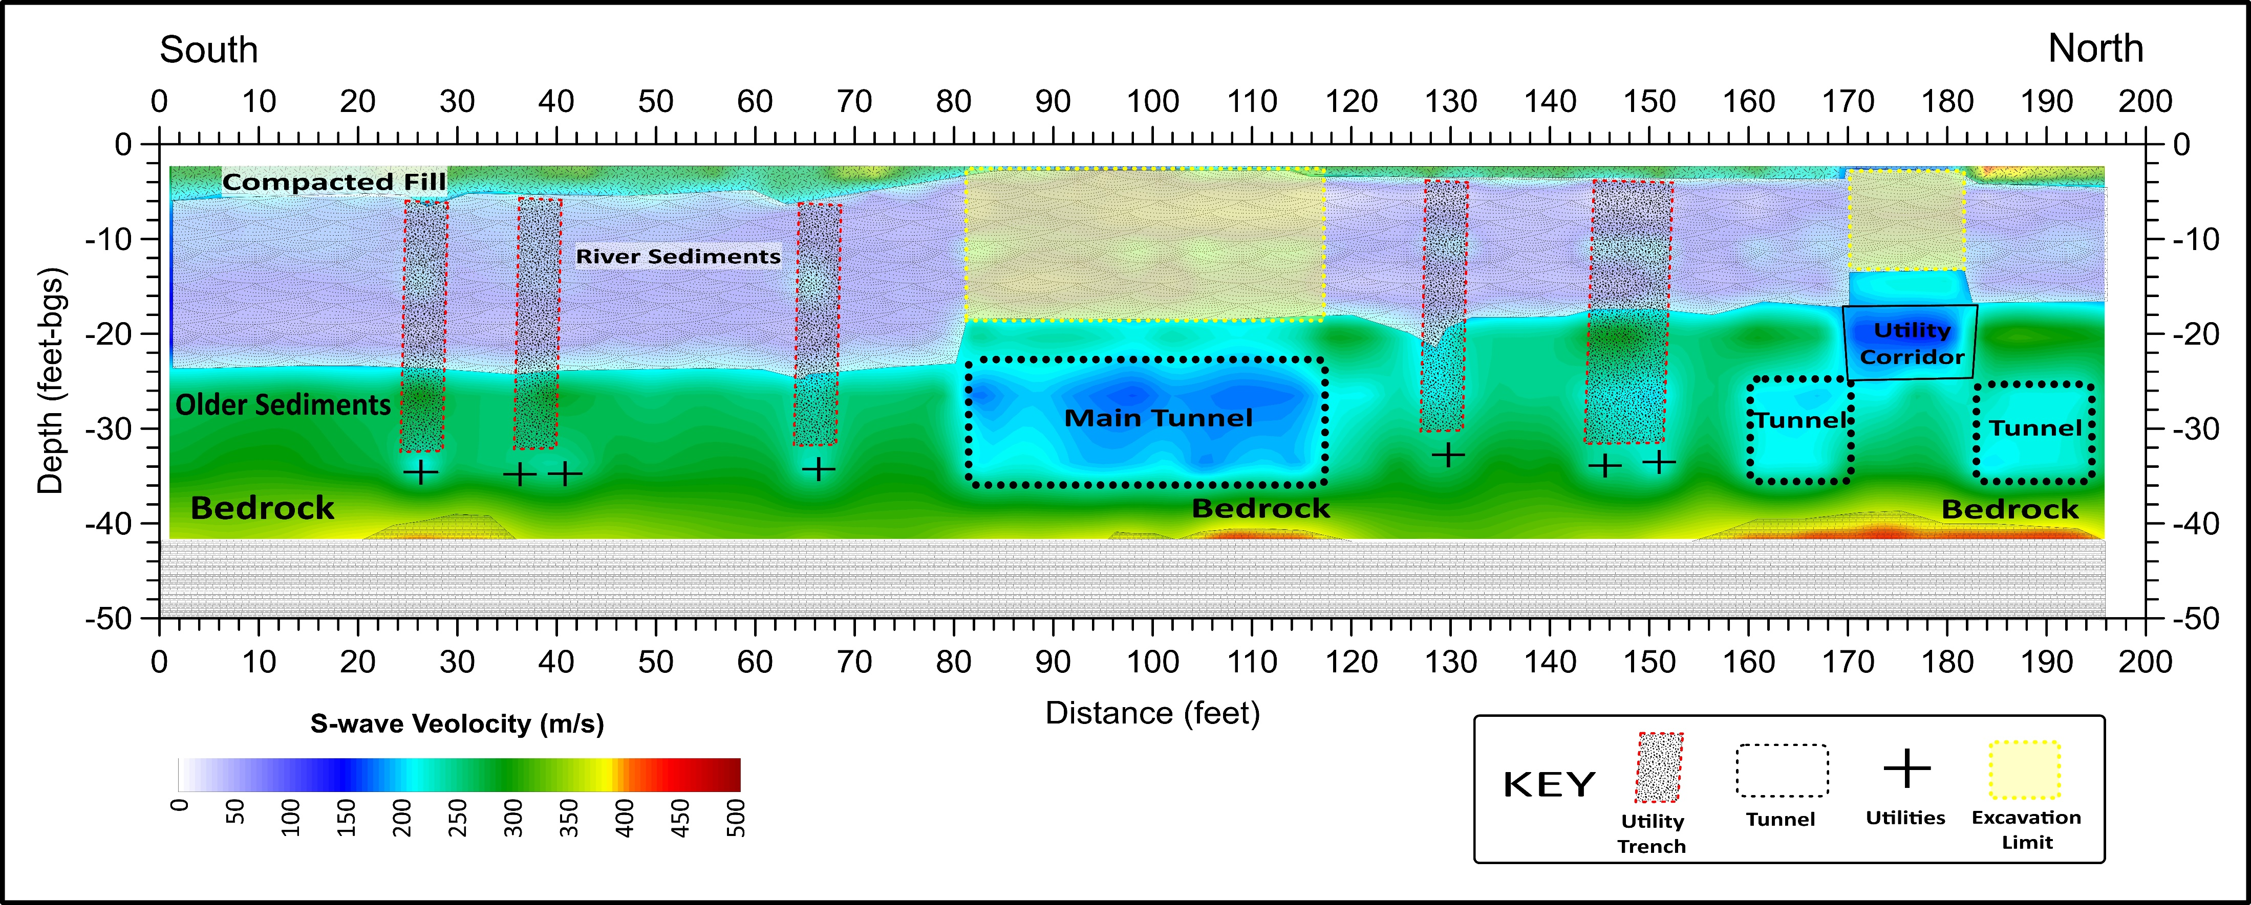
Precision Tunnel & Void detection
PROJECT DESCRIPTION
Parking lot site in downtown Minneapolis, MN that is being evaluated for commercial development
Deep (> 20 ft) utility corridors / tunnels were known to exist at the site, but no records of exact positioning information could be found
1line of MASW data totaling approx. 196 ft, and positioned perpendicular to the expected orientation of the tunnels, was collected on the surface of the parking lot
The MASW analysis shows the positions of several underground utility corridors, some of which were unknown to the potential land developers. The “main tunnel”, which was the primary target of the investigation, is clearly visible in the center of the cross section between stations X= 82 – 118 ft. Suspected utilities are interpreted to be located in low S-wave velocity anomalies at the bottom of previous excavations, which are also defined by low amplitude anomalies. No drilling study could create the detail available in this MASW cross section.

Slide 25
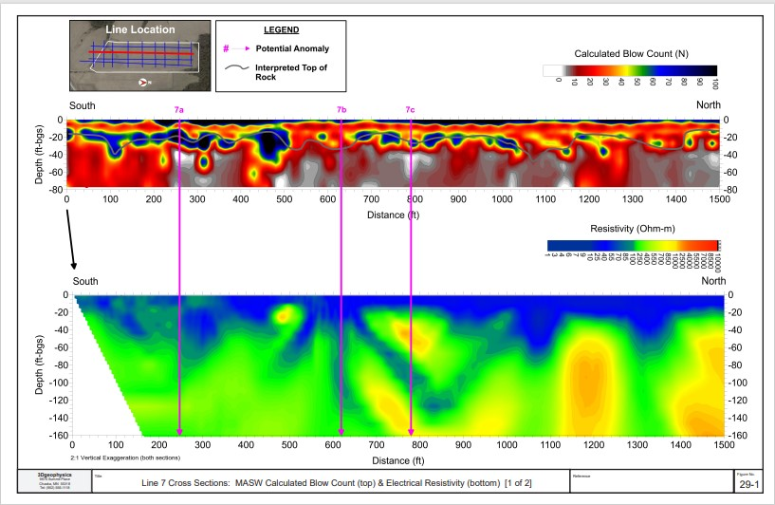
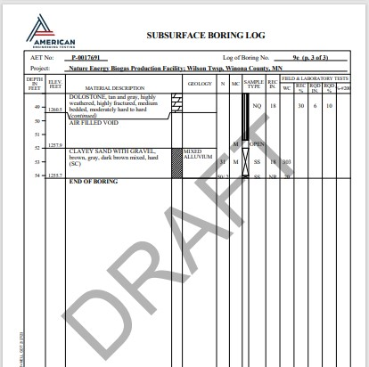
Karst Geology and Sinkhole EXPLORATION
PROJECT DESCRIPTION
Gas Plant geotechnical studies in advance of a new facility design on an active Karst Site. The site is located in Filmore County MN famous for sink hole and Karst Geology.
12 lines of MASW data totaling approx. 16,000 ft were collected across the footprint of the proposed facility to further test the soil properties.
The MASW data identified the extent of extremely low blow count (“N-value”) materials to depths of 80 ft across the site identifying air filled voids generally better than Resistivity.
An MASW cross section (shown at the right), provides an example of the strong correlation between the MASW-calculated blow count data and soil boring results that encountered Air Filled Voids.
Confirmation Boring B9E
MASW
Air filled void
Resistivity

Slide 26
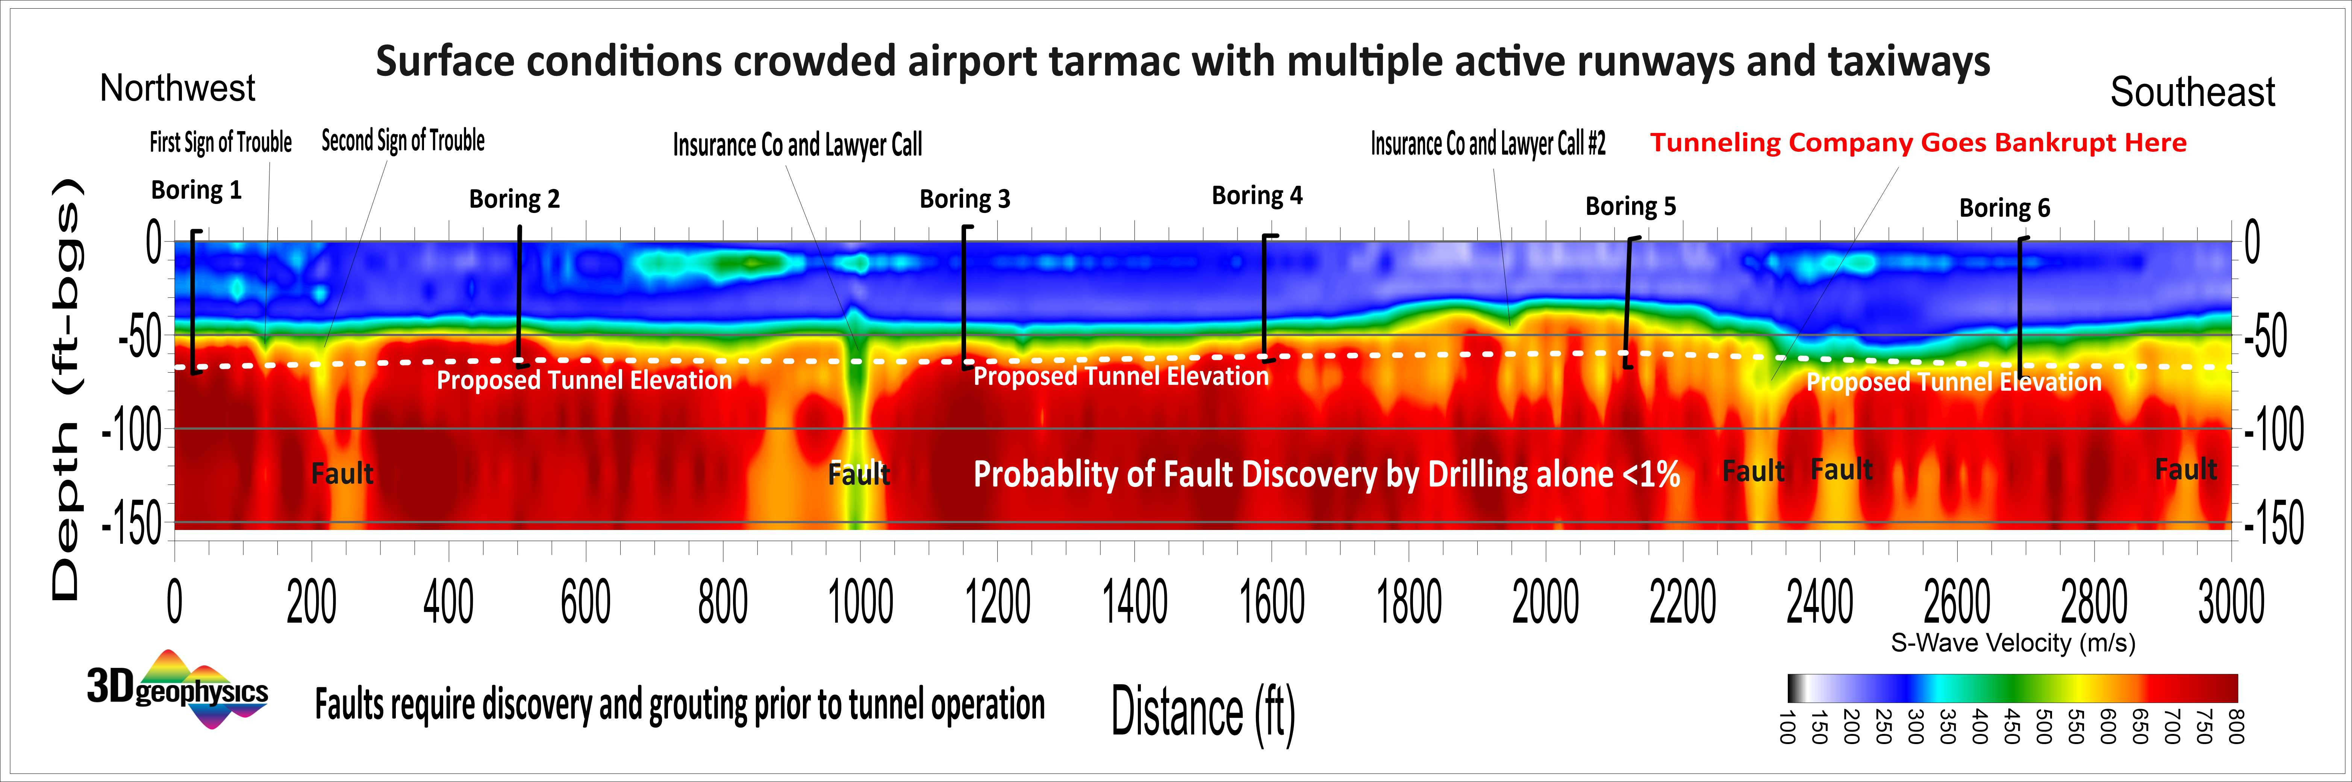
PRE-TUNNEL MASW SURVEY SAVES $$

Slide 27
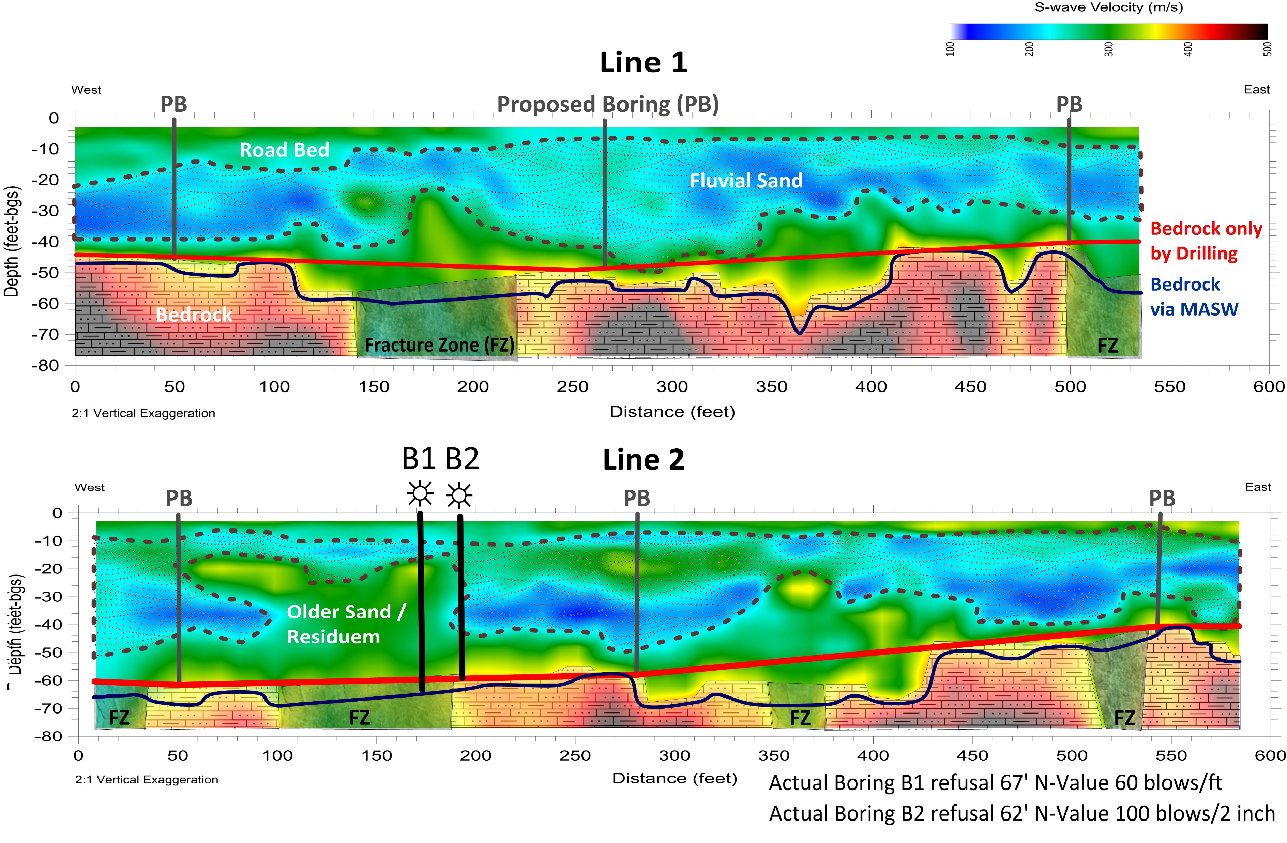
Foundation and Structure stability Review
PROJECT DESCRIPTION
Manufacturing site near Catlettsburg, KY that observed differential settling of overhead pipe rack support foundations that were causing infrastructure failure
2 lines of MASW data totaling approx. 1,120 ft were collected in parallel on opposite sides of subsiding foundations accurately predicted depth to bedrock a two test holes.
MASW data more accurately determined the structure of the competent bedrock (blue lines on cross sections), as opposed to the interpretation that would have been made from borehole data alone (red lines)
Boring 1 and Boring 2 verified the MASW model coming in at 67’ and 62’ refusal. The MASW results detail site variation standard drilling could not hope to detail.

Slide 28
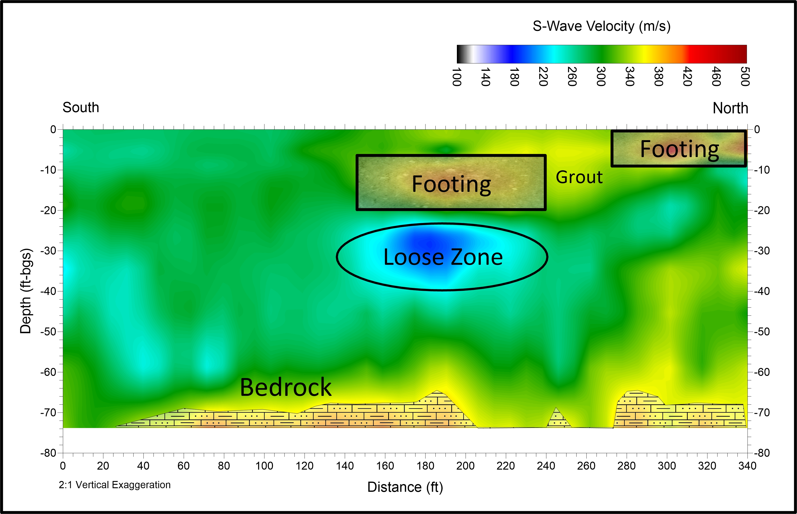
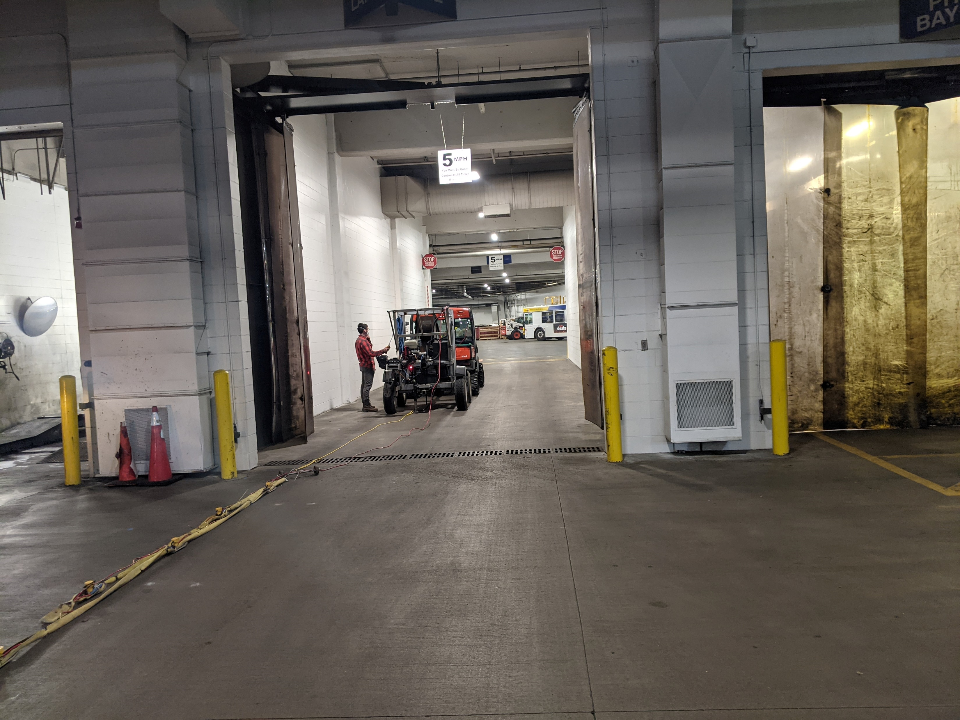
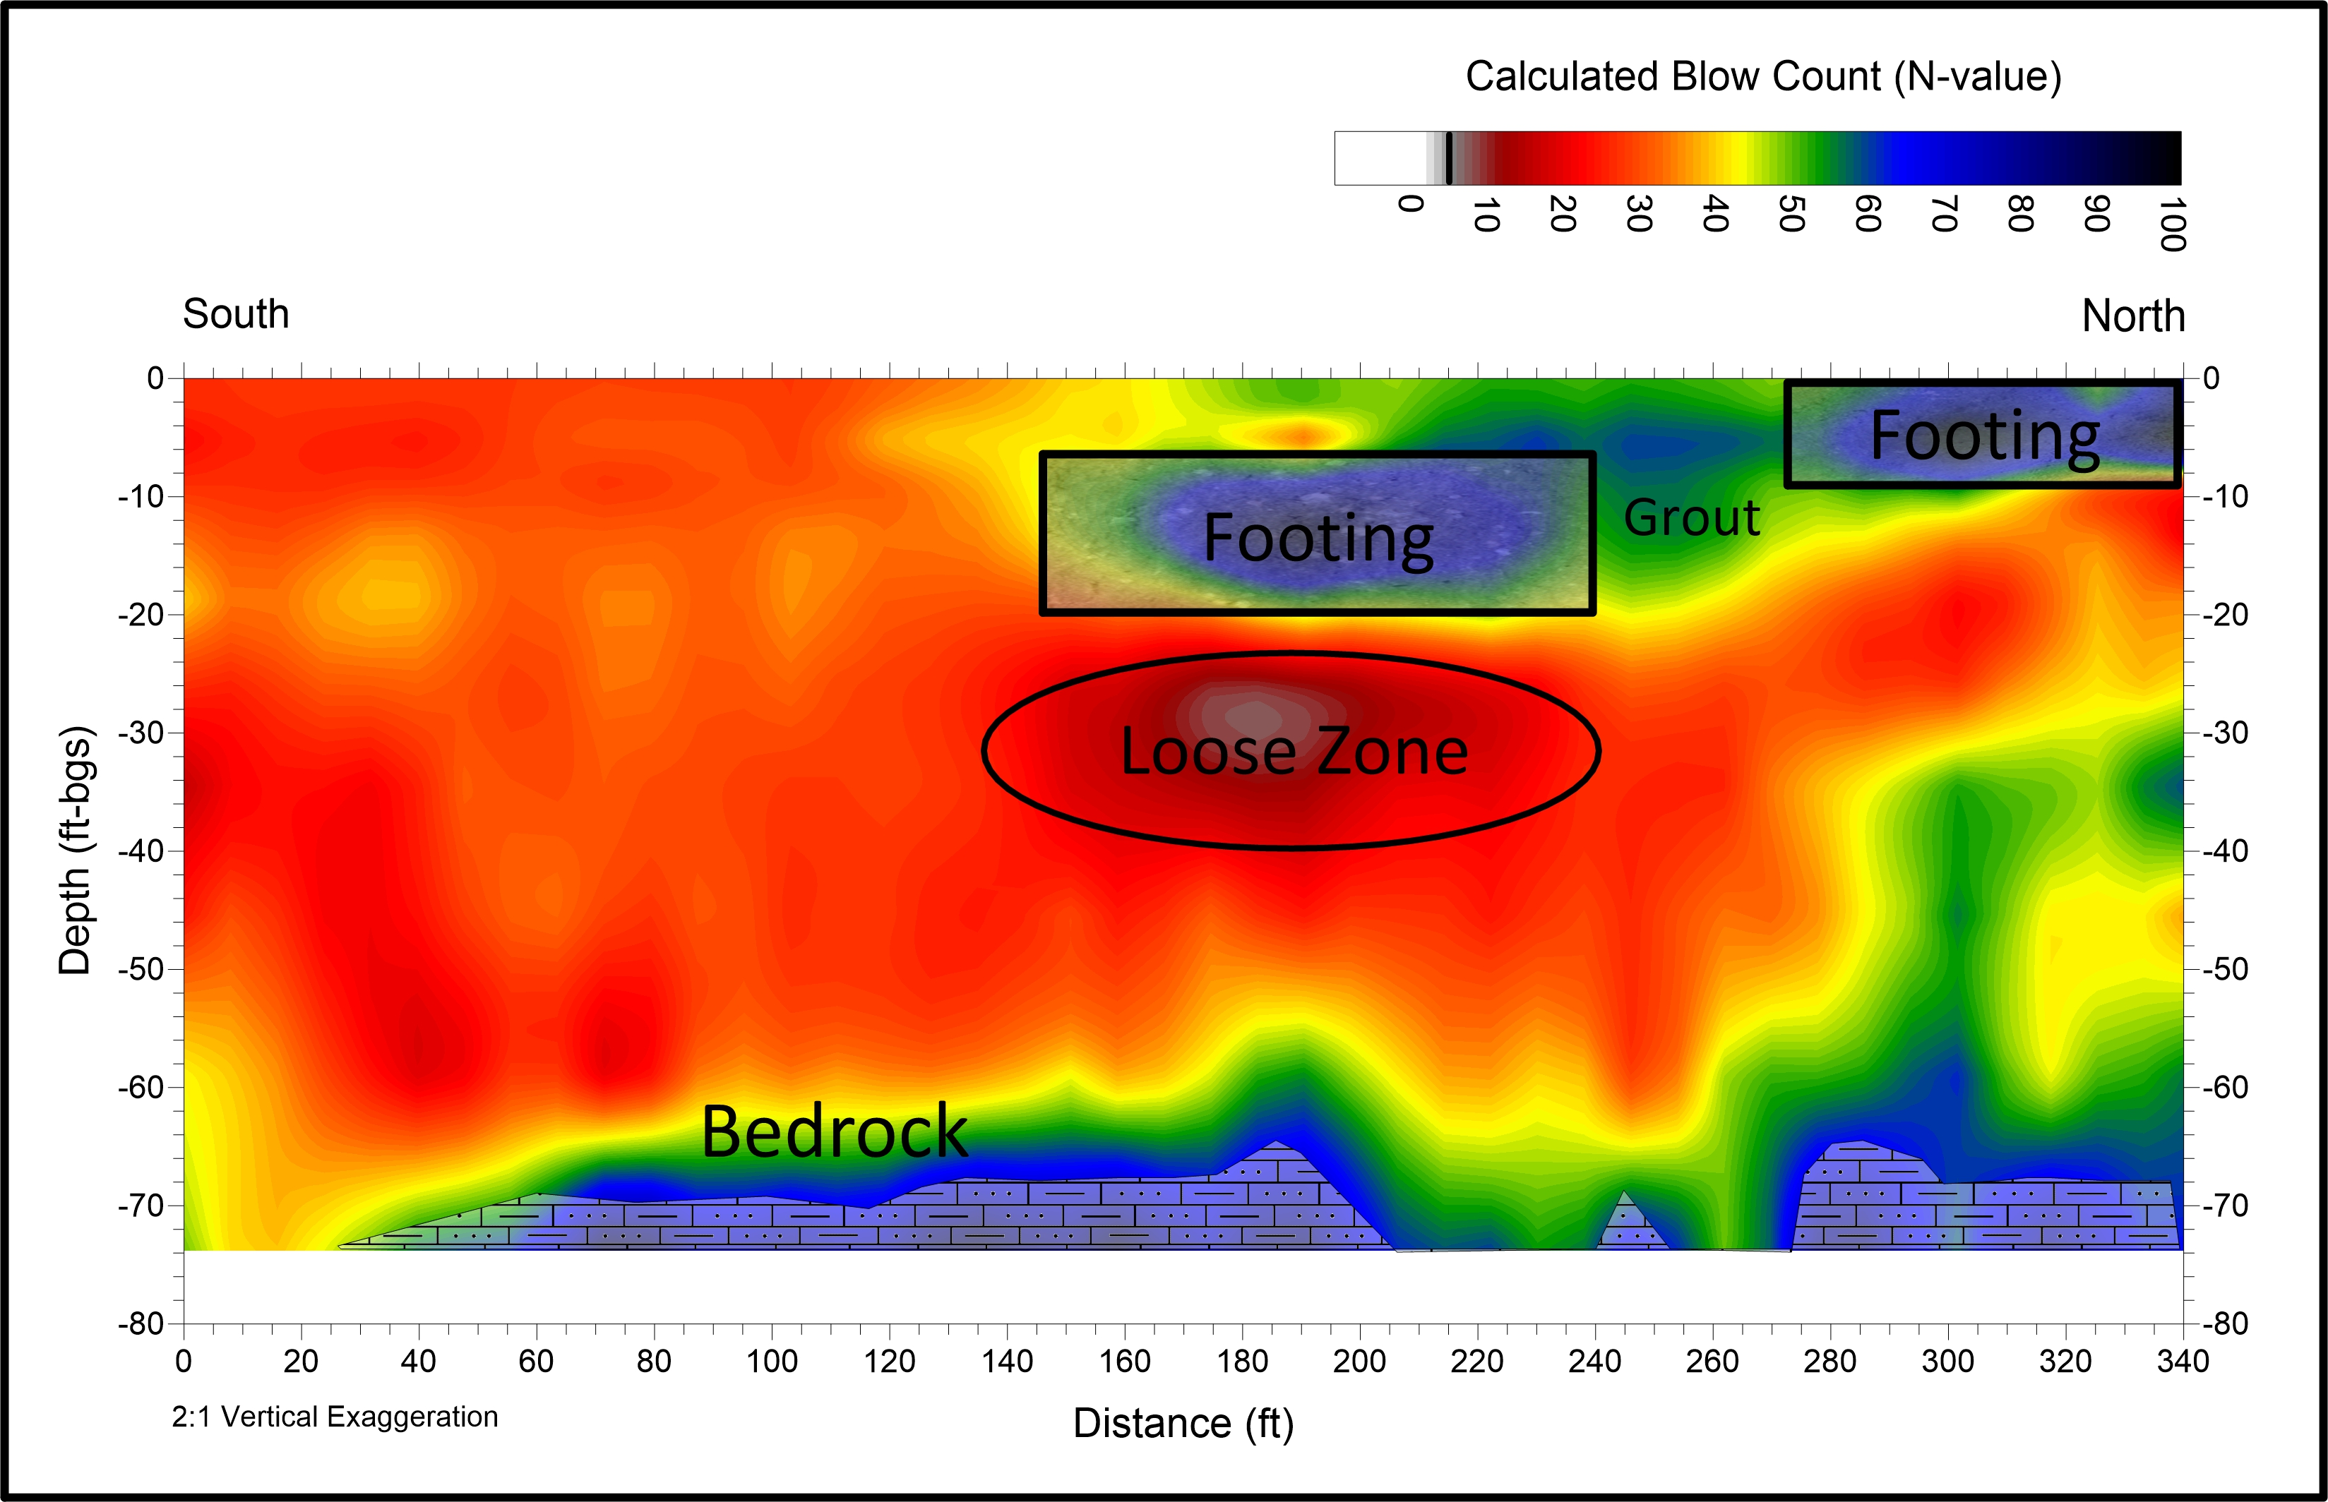
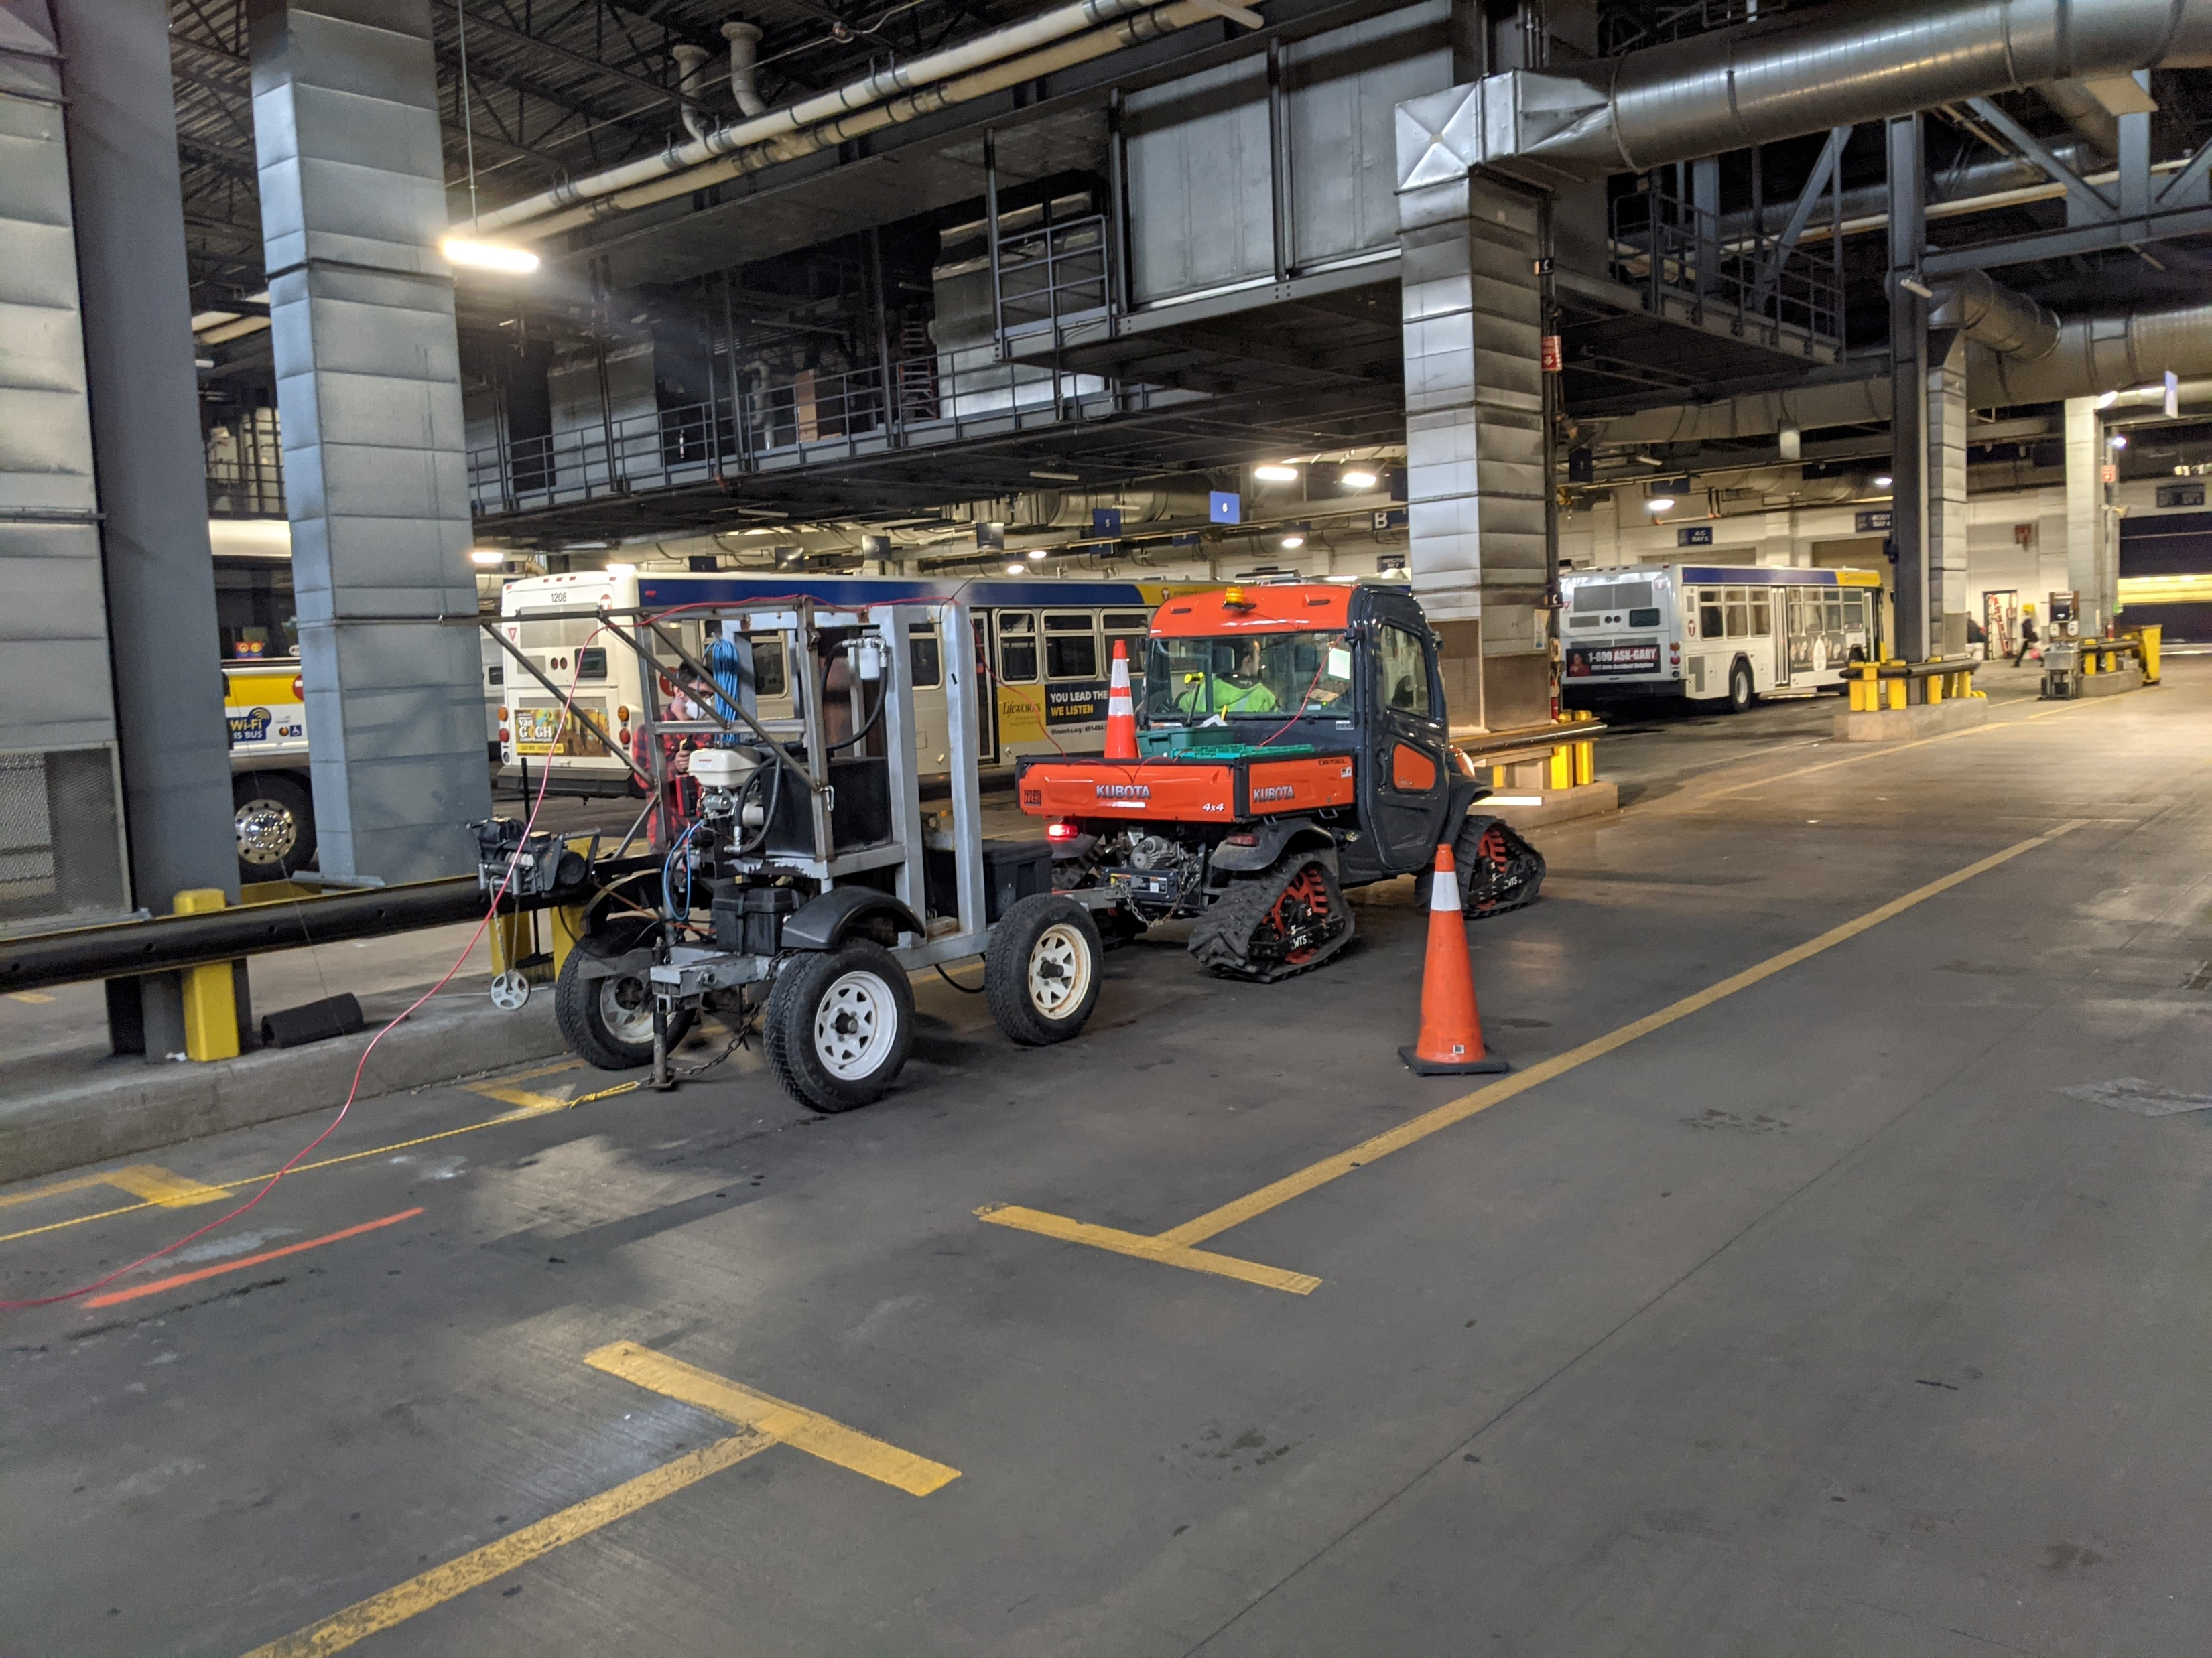
Foundation integrity/ Failure Study
PROJECT DESCRIPTION
Municipal transit vehicle Garage in St. Paul, MN that was experiencing settlement & failure in the concrete floor slab and structure.
7 lines of MASW data totaling approx. 2,805 ft were collected both within (where drilling is difficult) and outside of the maintenance & bus storage facility to identify zones of improperly compacted fill underneath the building floor slab.
The MASW data analysis precisely located low S-wave velocity anomalies (“loose zones”) beneath the floor slab that were deteriorating the structural integrity of the building .
On 1 of the MASW lines (shown at the right), loosely compacted sediments were imaged directly below a structural concrete building column in a way drilling could not.
S-wave Velocity Cross Section
Blow-Count (“N”) Cross Section

Slide 29
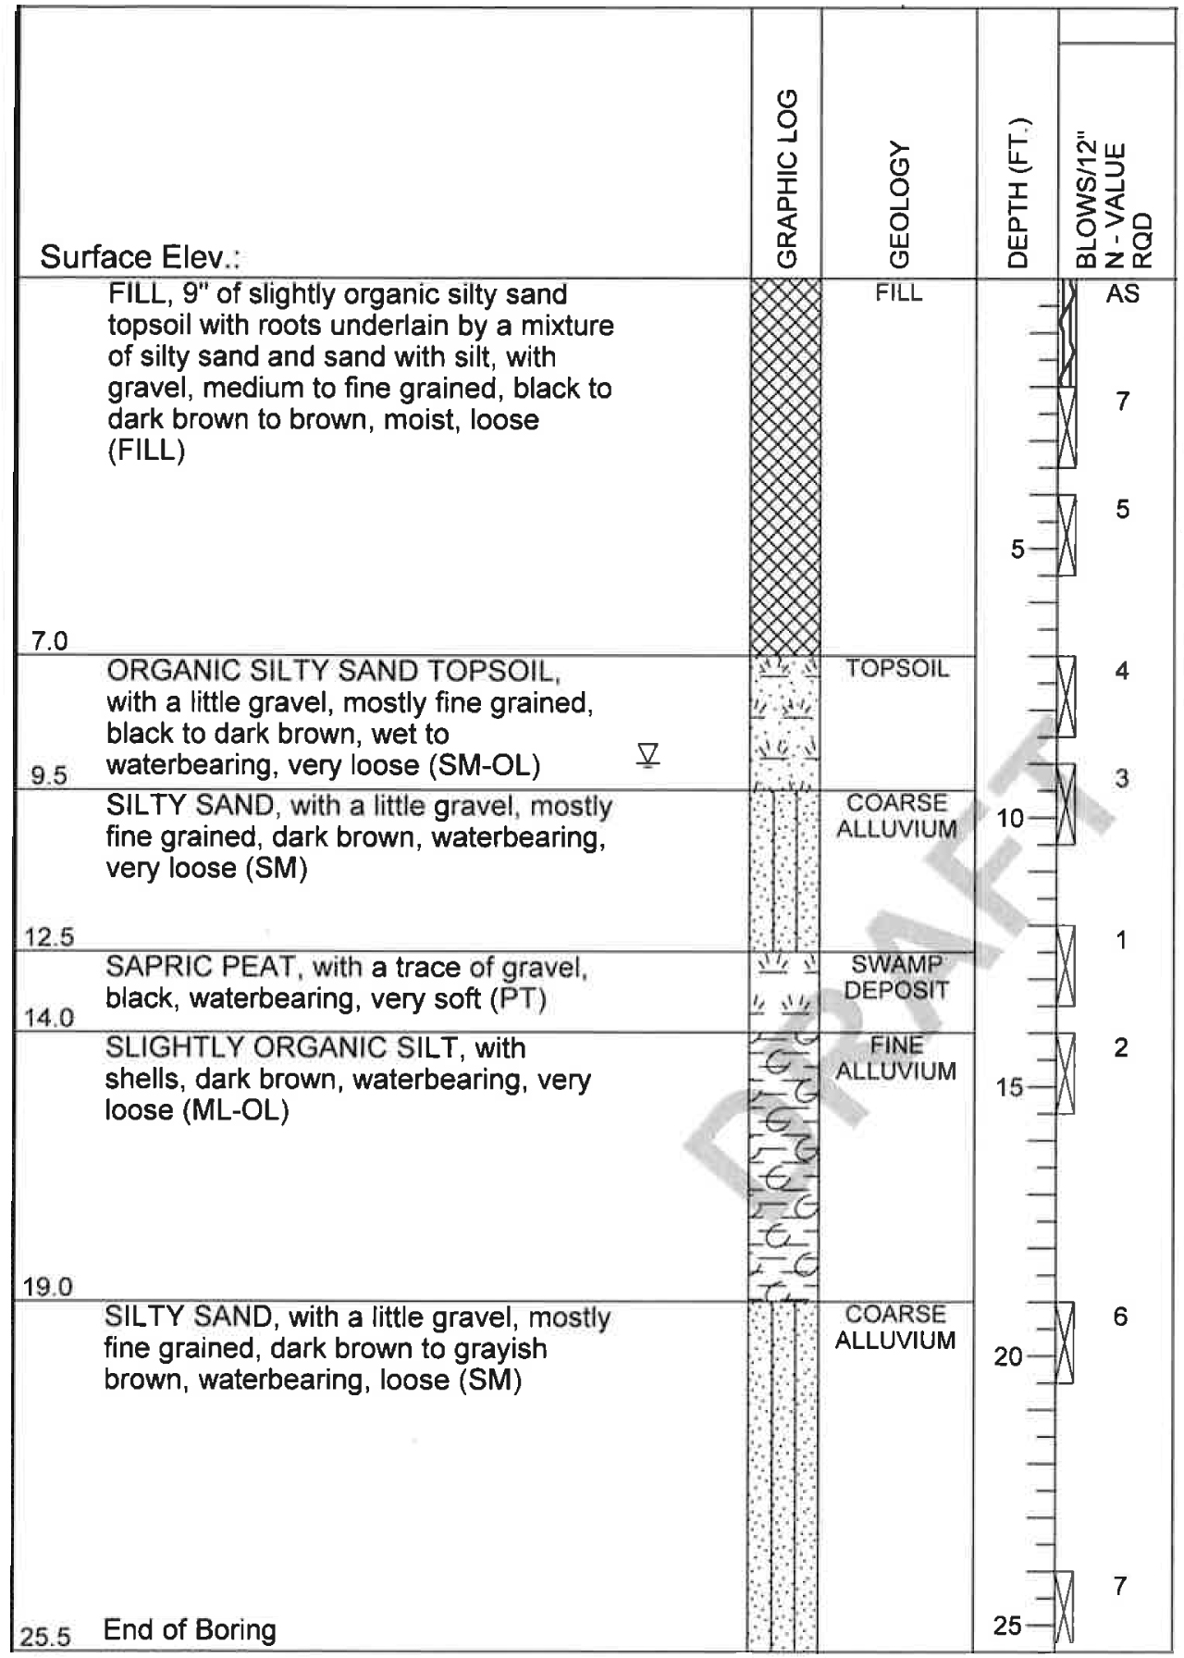
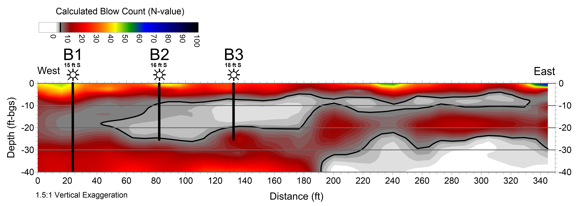
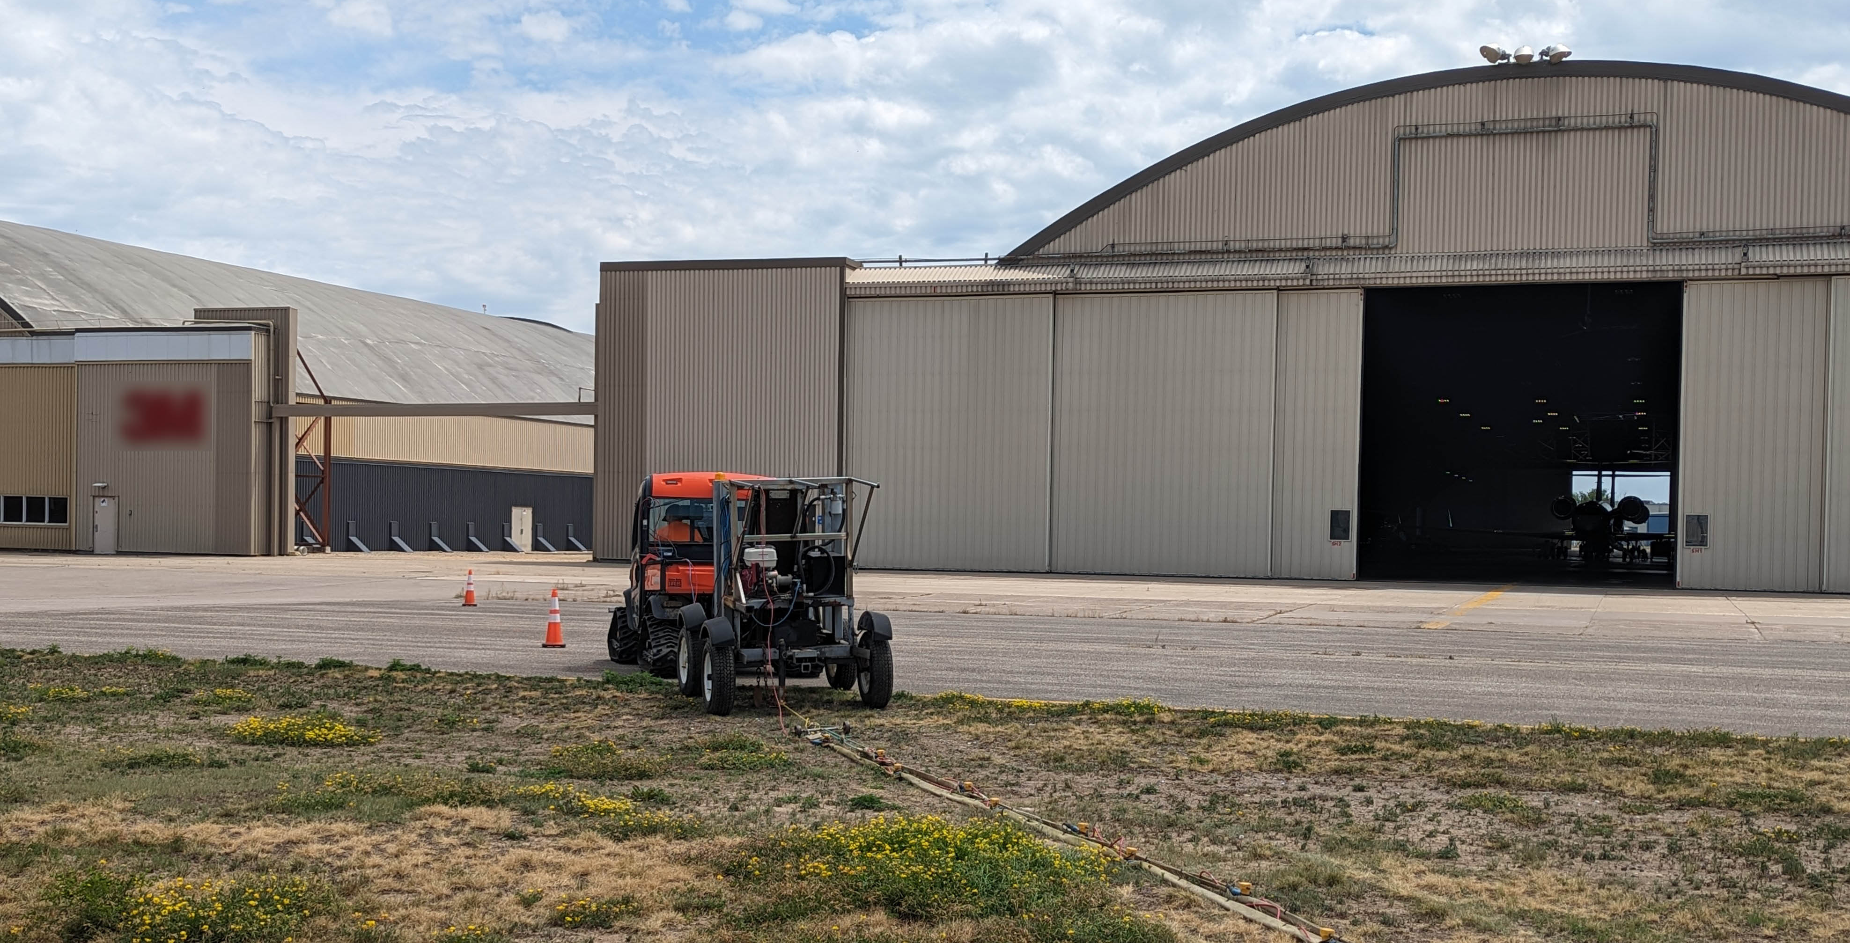
Pre-construction Site study
PROJECT DESCRIPTION
Airport facility in Minnesota performing geotechnical studies in advance of a new facility design. The mature site is located on a historic wetland and is known to have very loose organic soils and peat deposits in the near surface
4 lines of MASW data totaling approx. 1,380 ft were collected across the footprint of the proposed facility to further test the soil properties, supplementing the limited borehole program
The MASW data identified the extent of extremely low blow count (“N-value”) materials to depths of 40 ft across the site in a detailed manner not provided by available drilling techniques.
An MASW cross section (shown at the right), provides an example of the strong correlation between the MASW-calculated blow count data and soil boring results that was representative of all of the collected data
The mapped extent of organic & peat deposits within the survey area will help geoengineers to determine a structurally appropriate building foundation design (floating vs deep piers into hard rock)
Boring B3
Soil Boring vs MASW Correlation

Slide 30
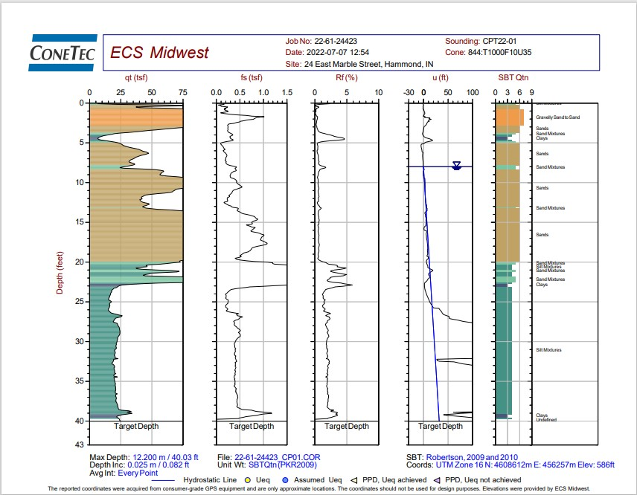
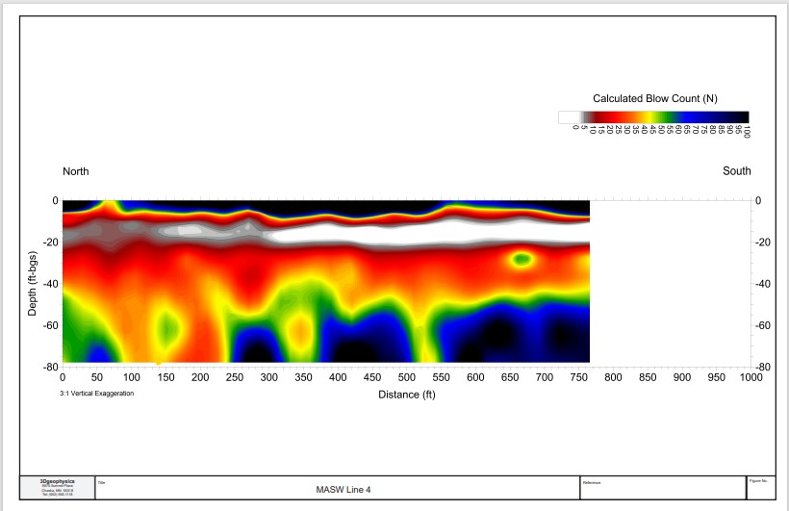
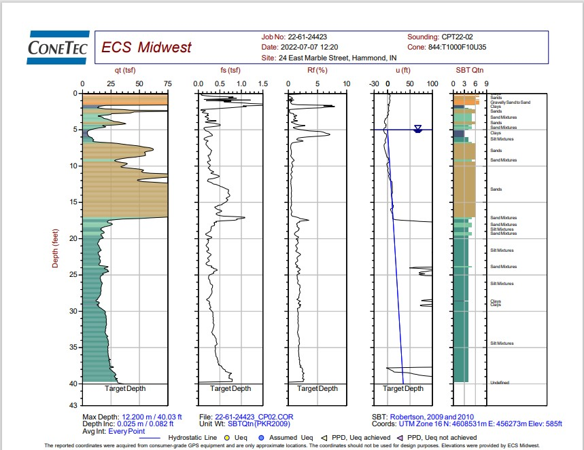
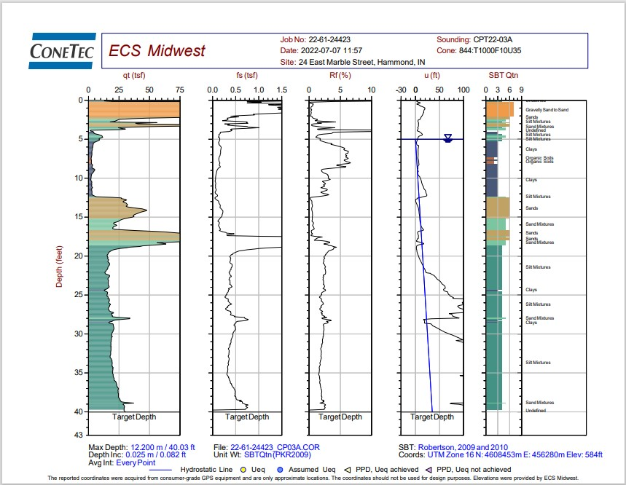
Buried Organic sediment Mapping
PROJECT DESCRIPTION
Old Industrial Site surrounded by swamps bordered by a river and coated with concrete debris. The site is located near Chicago.
5 lines of MASW data totaling approx. 4000 ft were collected across the footprint of the proposed facility to further test the soil properties and provide details drilling could not.
The MASW data identified the extent of extremely low blow count (“N-value”) materials to depths as deep as 25 ft across the site
An MASW cross section (shown at the right), provides an example of the strong correlation between the MASW-calculated blow count data and cone data
Low strength organic sediment
MASW and ConeTec

Slide 31
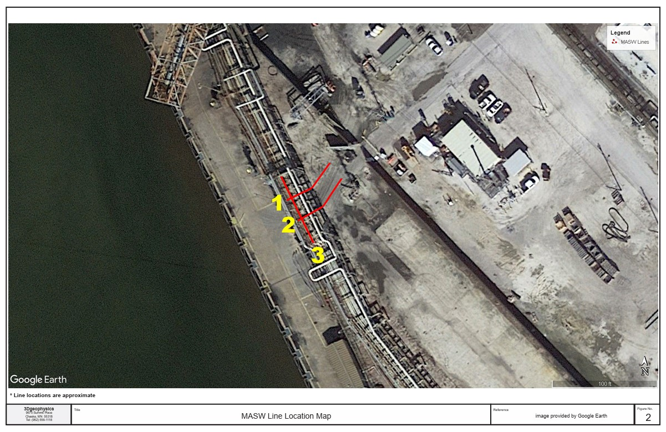
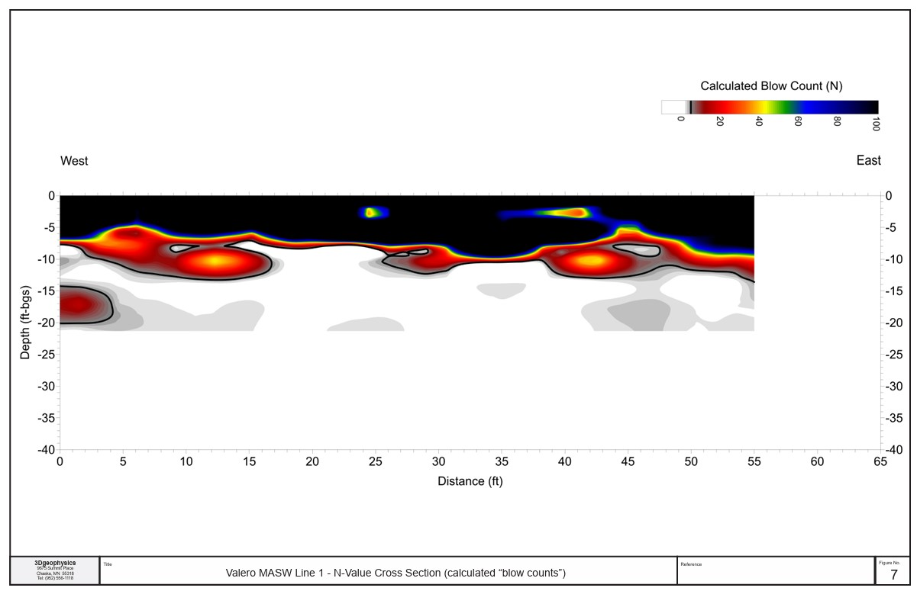
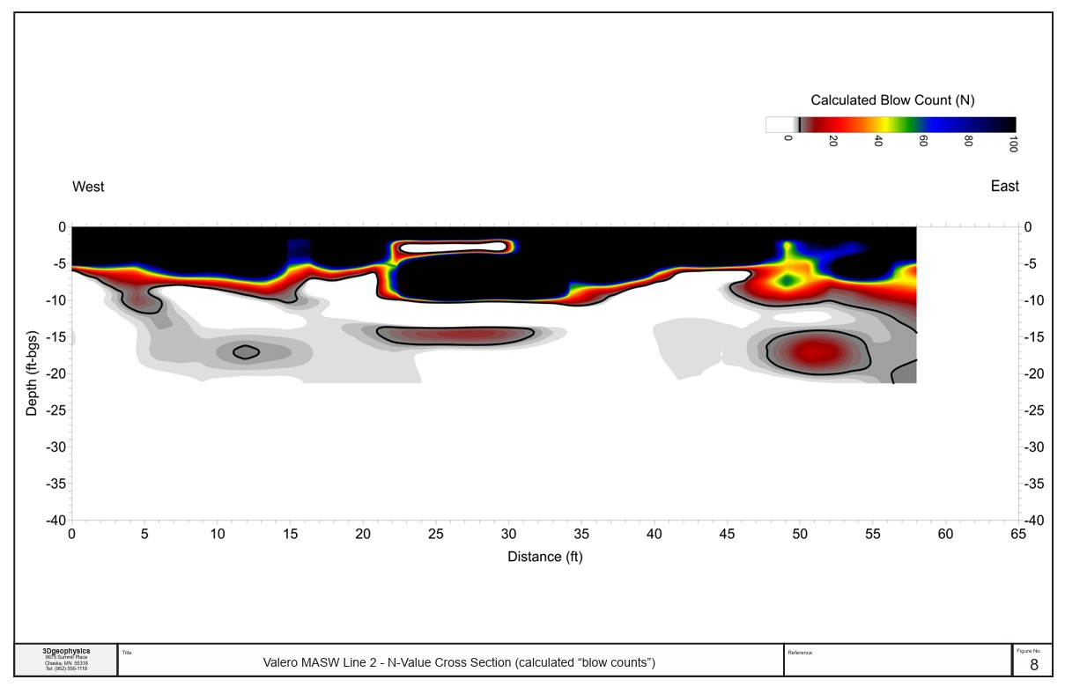
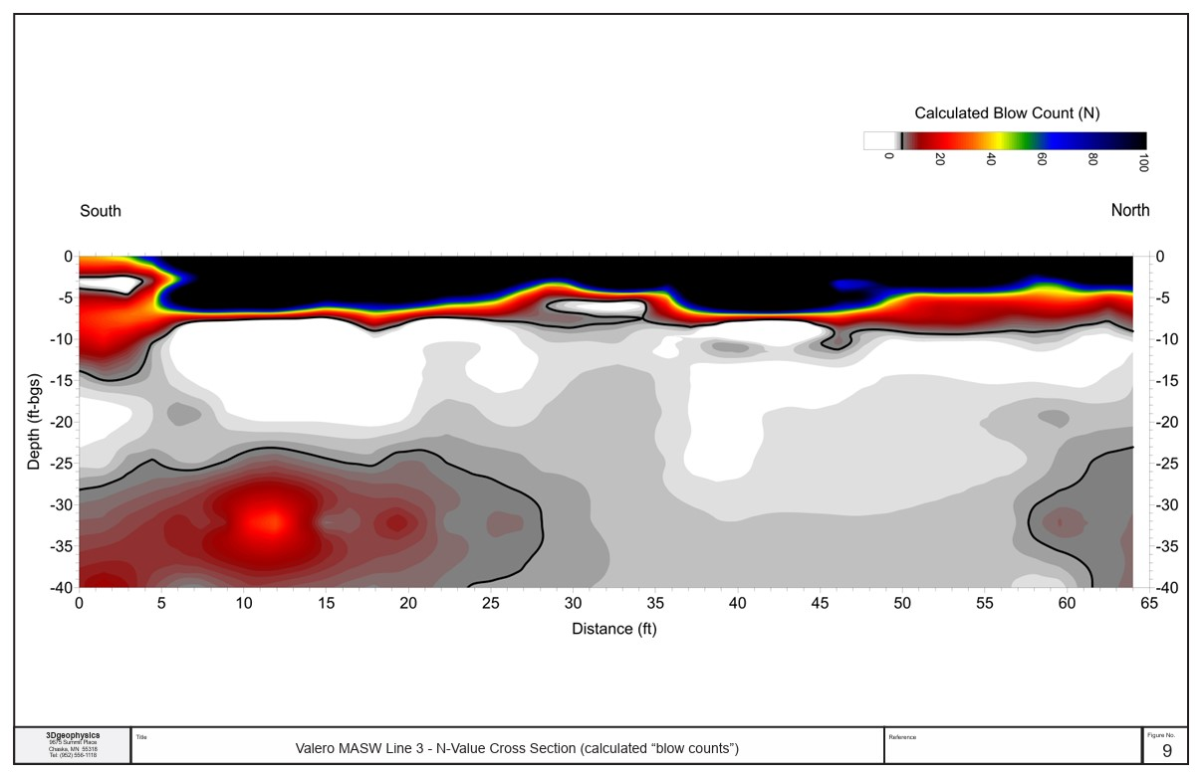
Low Strength
Sediment
Engineering
Line 1
N=1
Line 2
Line 3
N=1
N=1
Drill Free Blow Counts
Be Safe Not Sorry

Slide 32
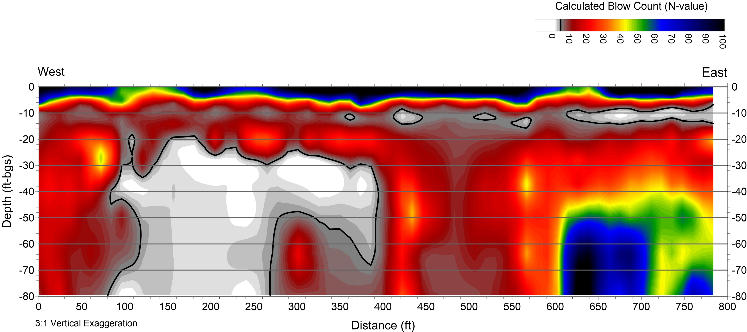
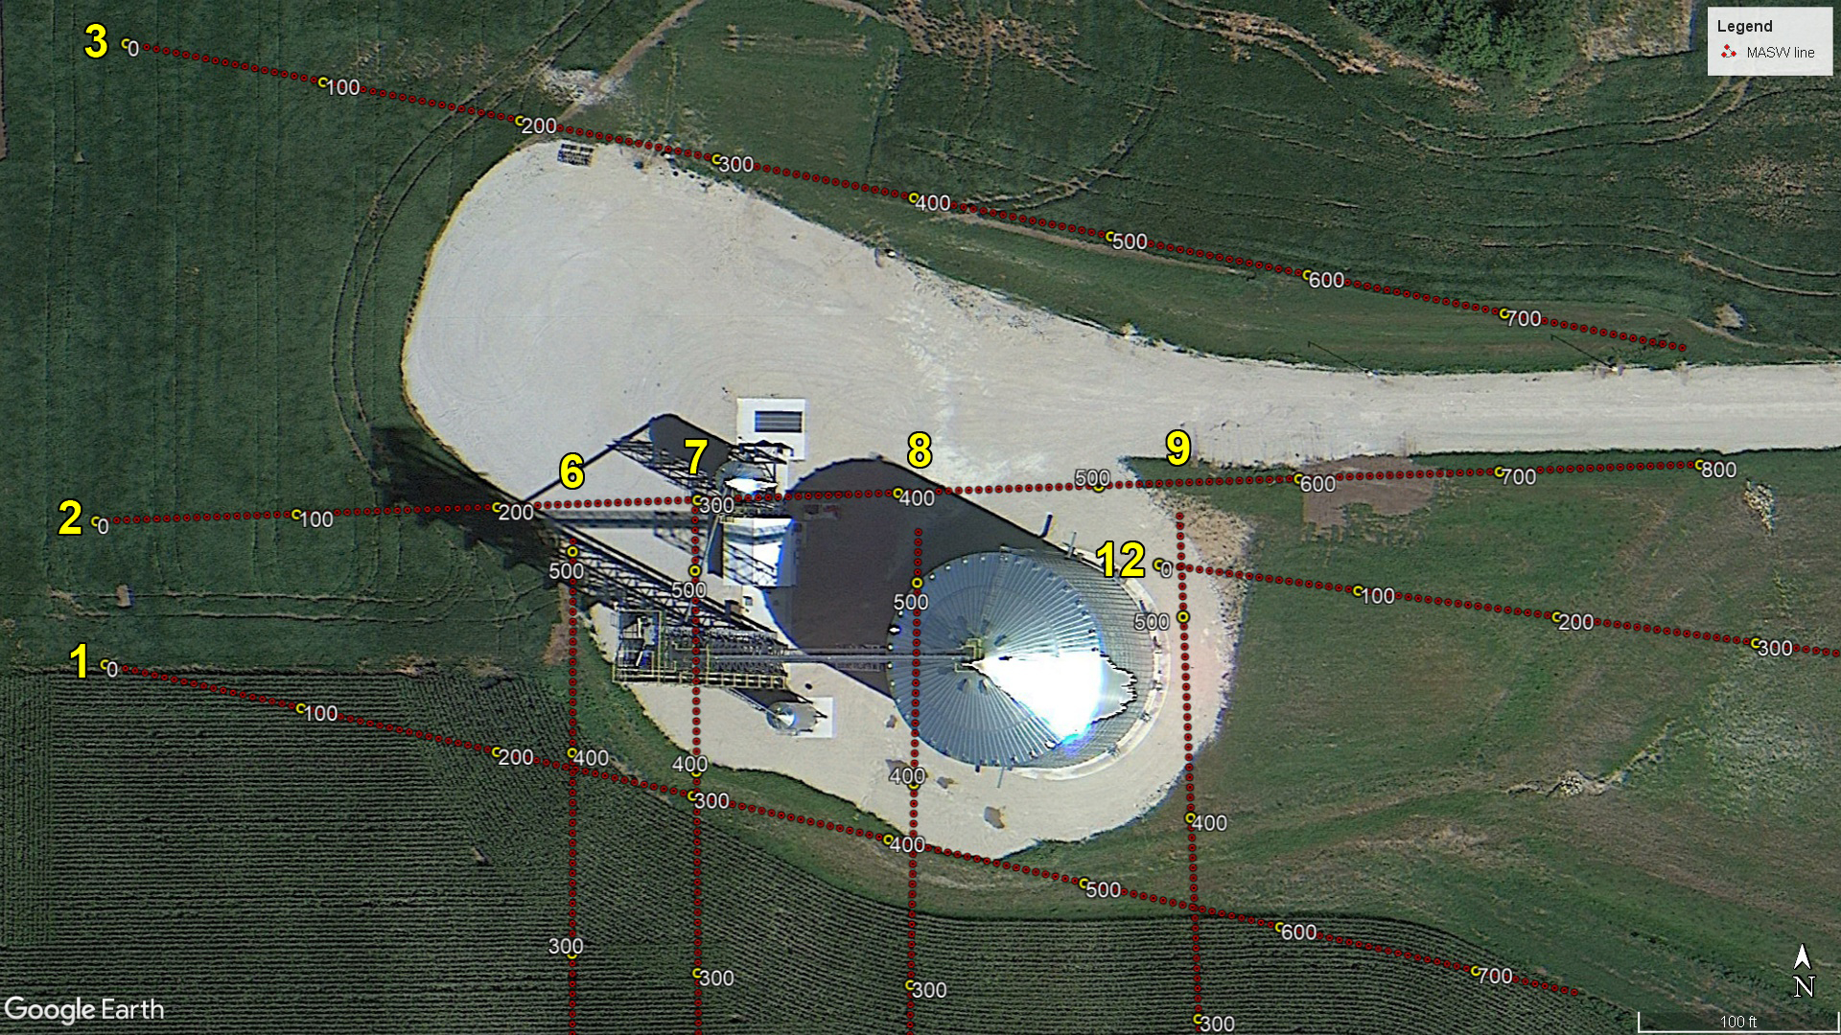
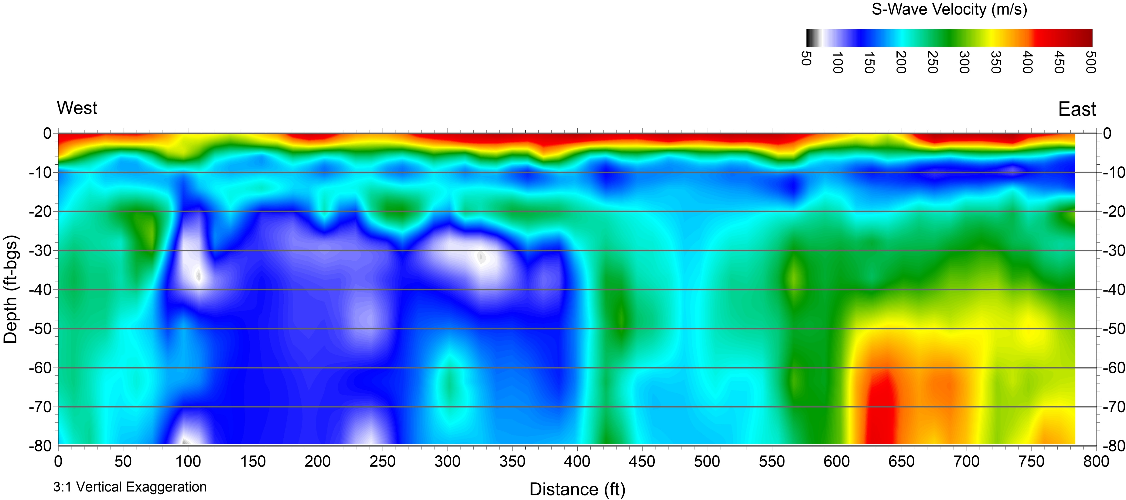
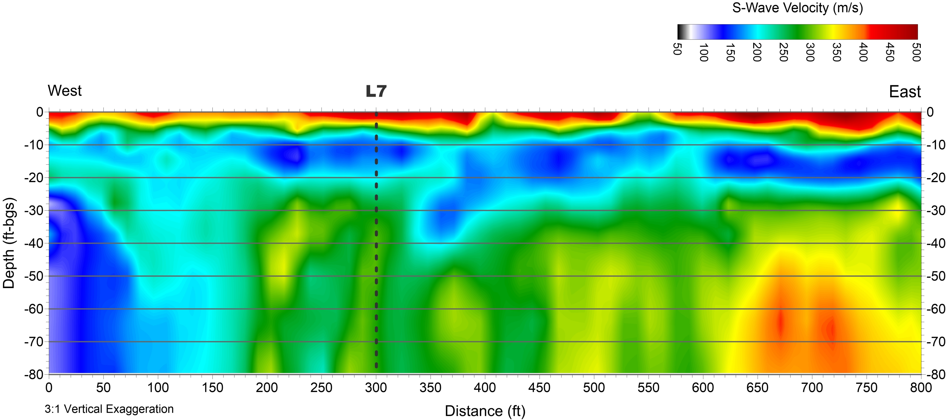
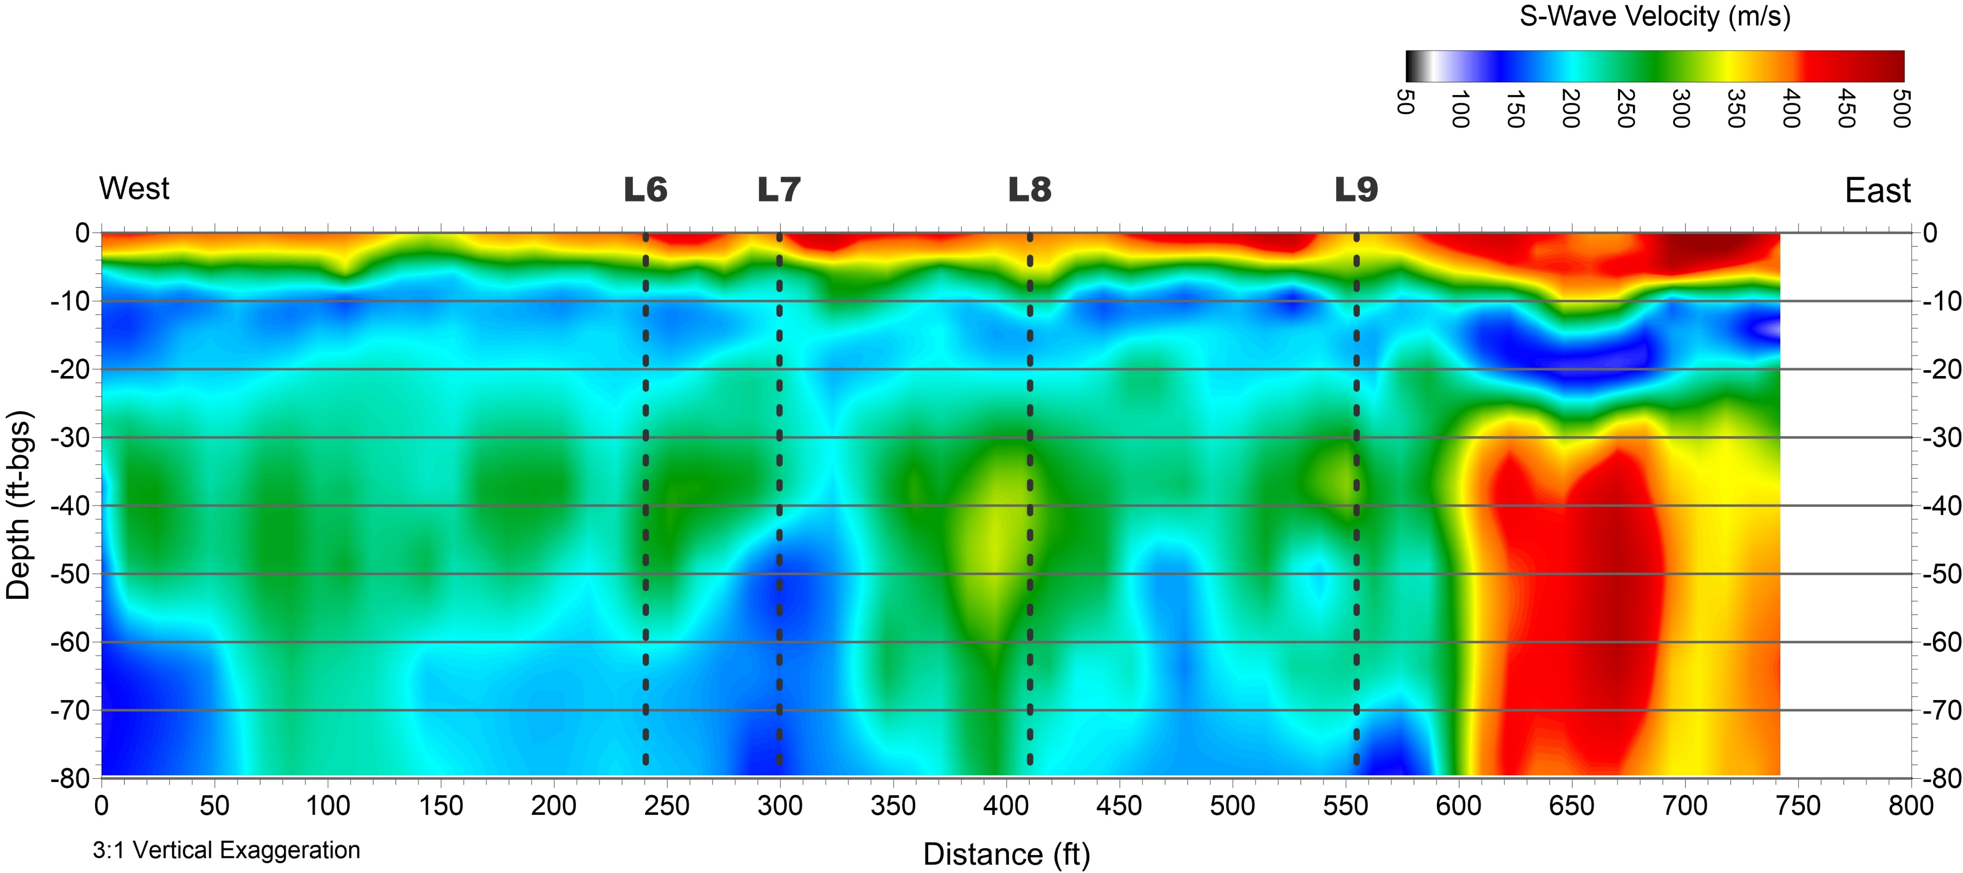
Faulted Site - Downthrown Block Fills with Low Strength Material
Standard Penetration Test “N” Value
N=one
Fault Line

Slide 33

Be sure you are on Bedrock with MASW

Slide 34


Dam Strength and Integrity Survey
Line 1
Pathway and Leakage Survey

Slide 35




MASW Through The Rails

Slide 36





Jacking Pipe With
Nearby Bedrock
Line 5
Line 3
Line 4
Line 2
Do not try this at home

Slide 37

MAP RIPPABLE MATERIAL BELOW AUGER REFUSAL

Slide 38


Slide 39



Ground improvement/Grouting Performance
PROJECT DESCRIPTION
Commercial site near Suwon City, South Korea that observed differential settling of a building foundation
1 line of MASW data totaling approx. 174 ft (53m) was collected at 3 different time intervals BEFORE and AFTER cement grout was injected into 10 boreholes @ 50 ft depths to strengthen the underlying sediments
MASW data clearly show the strengthening of sediments after remediation efforts with measured increases in S-wave velocities / Stiffness (Left figure)
Velocity comparison analysis (before vs after) show > 100% velocity increases at the target depths 2 months after grouting (Right figure)
MASW S-wave Velocity Cross Sections
Before vs After Grouting Velocity Analysis
Dats & images provided by Park Seismic, LLC

Slide 40


Low Cost - Large Scale - Bedrock mapping
PROJECT DESCRIPTION
Industrial site near Los Angeles, CA that was experiencing the migration of contaminated groundwater through the shallow bedrock
21,300 linear ft of MASW data were collected on concrete & asphalt roads within the approx. 500-acre site boundaries (black lines on map) Inside of 3 field days.
Top of competent & weathered bedrock were interpreted from the MASW data, which were used to guide future invasive sampling to assist in environmental remediation at the site. The data coverage is beyond what is possible with drilling at any price.
Competent Rock

Slide 41


Hazard Screening of Crane “Walks”
PROJECT DESCRIPTION
Renewables are HOT. WIND is up and going. Cranes are in a BIG HURRY.
Once the 3 man crane assembly team has the largest walking crane on earth assembled ( 3 days min) they do not like to dissemble them.
As a result the erection team attempt to walk the crane - tower up - from lift pad to lift pad. This is when the crane is most exposed. If the ground fails the crane topples.
MASW taken continuously along the crane “walk” provide the affordable continuous protection to constantly screen for low strength soils like Peat below the crane tracks in a way drilling could not
MASW LINE 1168
Buried Peat

Slide 42


When It All Just Looks Like Corn

Slide 43



Affordable Bedrock Study - Basement Parking
PROJECT DESCRIPTION
DT Building plans for underground parking without bedrock info.
Downtown site is complicated drilling with many buried utilities .
MASW is used to map bedrock elevation without expensive drilling.
Data is collected in 5 hours onsite no utility damage.
Bedrock
High
Complicated Utilities
Bedrock
High

Slide 44


Structure Failure (Damage) Study
PROJECT DESCRIPTION
Lite Rail Construction pile driving caused obvious settlement in adjacent building
MASW is used to map bedrock elevation and fill status below building - without expensive drilling.
Results detail the loose zones of interest.
Line 1
Line 1

Slide 45



Deep Fill Pocket Investigation
PROJECT DESCRIPTION
Bridge Project Probes discovers unexpected deep fill pocket previously not known by the Minneapolis bridge department.
MASW is used to map the details and extent of the loose fill the way drilling really cannot.
Boreholes were advanced to confirm the MASW findings. Boring information and MASW profile show near perfect correlation.
Road base repair
Line 2
B-7
Road base
Deep
Loose
Fill
Bedrock
Deep
Fill

Slide 46





Low Cost Aggregate Exploration
PROJECT DESCRIPTION
Aggregate is needed for concrete and it is in short supply.
Typically Concrete firms will keep options on thousands of acres for potential mining using relatively low cost agreements.
If markets change and more aggregate is needed the purchase price of acreage dictate a more careful assessment of available resources.
Since the sample interval (move up) can be adjusted from 1 to 100 feet this 100 acre map used 50 ft sampling and took only 7 hours to collect. Drilling is unable to afford such resolution at these economies.

Slide 47



Reliable Shallow Void Detection
Reliably mapping voids below and behind concrete with reinforcing steel is difficult.
Proprietary High Frequency Source with High Density Receiver Array (1200 Hz)
Reinforcing Steel Often Renders GPR Images useless MASW is unaffected by STEEL
The data coverage is beyond what is possible with drilling at any price.
Known Void

Slide 48


Concrete Basin Evaluation
PROJECT DESCRIPTION
24” Thick Concrete Basin floor poured on 18” thick bed of crushed rock in very challenging winter conditions.
Photos show rock placed on snow then concrete placed on top of that.
The 24” thick concrete basin base has two layers of heavy rebar reinforcing making GPR analysis for voids impossible
A special high frequency MASW source and very tight receiver array were used to map crushed rock thickness anomalies and concrete strength anomalies which did correlated to low break strengths from coring.
Weak Concrete

Slide 49


Industrial Food Process Evaluation
PROJECT DESCRIPTION
BIG Potato provides the world with golden fries and it is serious business.
The process of making Billions of French Fries yields a lot of potato peels and organic silt (waste).
In order to deal with the waste HUGE (300’x900’) digesters try to “Eat” the waste and pump it out as “wastewater”.
Sadly the digesters do not always work well and you end up with a coagulated island composed of desiccated potato peel floating in your digester basin causing basic system failure.
When an engineering team tried to probe, then drill the “island” for thickness they failed to penetrate the material. MASW was used along Line 1 to measure the “Island” thickness. As expected the technique worked well.
MASW can clearly map thickness and change in thickness across the island. The SH velocity of the peel island is near the speed/strength of weathered bedrock in some places.
Test Line 1
Floating Potato Peel Island
Digester
Basin
Silt
Silt

Slide 50
“After careful examination of hundreds of miles of MASW data
it finally occurred to me that we should not be relying on drilling information alone for Geotechnical Site Characterization. The spatial sampling cannot possibly discover the CRUX aspects of the site that keep the project on time, under budget and out of litigation. In fact, the only way to conduct a cost effective boring campaign on most sites is to first conduct an MASW survey to help direct and make sense of the boring data. “
Mike Rowee 2019

Slide 51
The Global Leader in MASW and Dispersion Analysis
Service * Sources * Accessories * Consultation * Training * Hardware * Software
3Dgeophysics Corporation
9675 Summit Place
Chaska, MN 55318
Brian Herridge
612.889.9520
Brian@3Dgeophysics.com

